Slide 1
Action Today for All our Tomorrows
16th November 2022
Natalie Turner
Millie Brown
Rachel Monaghan
Notes:
Delighted to be here with you all.
Many of us are still getting used to being back out in the real world doing face-to-face events
and it’s fantastic to be able to do that here in Lincolnshire today.

Slide 2
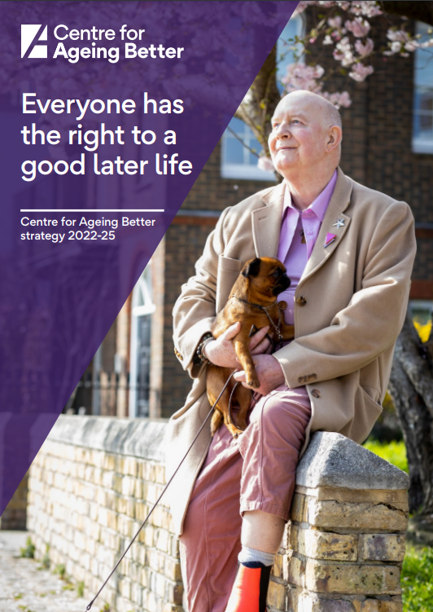
Who we are
An independent charitable foundation.
We are funded by an endowment from the National Lottery Community Fund.
We are part of the network of What Works organisations that promote the better use of evidence in policy and practice.
Pioneering ways to make ageing better a reality for everyone
Our vision is a society where everyone can live a good later life
Notes:
We want more people to be in good health, financial security and be treated fairly and with respect as we grow older.
This is why we are pioneering ways to make ageing better a reality for everyone.
We do this by:
Developing new ideas for policy and practice, and testing them out
Identifying effective practice and innovation and supporting widespread uptake
Campaigning and influencing

Slide 3
Taking action
Age-Friendly Movement and tackling ageism
Age-Friendly Employment
Age-Friendly Homes
Notes:
More clearly needs to be done.
For our part, we are taking action across three different areas
We’re building an age-friendly movement across the country including a bold campaign to stamp out ageism.
We’re influencing policy and practice so that everyone has access to good jobs, that are right for them, through their 50s and 60s.
We’re working to ensure everyone can live in age-friendly, accessible, healthy homes in intergenerational communities.
We need a fundamental shift in the way people think and feel about age and ageing, and how they act.
So I’m going to go into a bit more detail on the first of these, age-friendly movement

Slide 4
Age-friendly Movement
We're building a social movement to change how people think, feel and act about ageing.

Slide 5
Age-friendly Movement
We’re building a social movement to change attitudes and put tools and inspiration in the hands of those that can create change.
This includes:
Campaigning against ageism
Growing the UK network of Age-friendly Communities
Working with sectors to adopt more age-friendly approaches
Campaigning for an Older People’s Commissioner for England
Notes:
We’re building a social movement to change attitudes,
increase awareness of our ageing society
and the need for change…
…putting tools and inspiration in the hands of those that can create change.
This includes:
Campaigning against ageism, and influencing how ageing is portrayed in society
Growing the UK network of Age-friendly Communities and influencing more places to share and adopt good practice
Working with sectors and industry to adopt more age-friendly approaches
Campaigning for an Older People’s Commissioner for England - an individual with official powers to investigate relevant issues, gather information and make public bodies respond to their findings and recommendations.
Someone to act as an advocate and give older people a real voice.
This is where we can really see the blend of the work we do nationally – like influencing government, campaigning – with the work we do with partners locally.

Slide 6
UK Network of Age-friendly Communities
World Health Organisation affiliated
58 members across the country
We want to growing the Network to cover more places across the UK, and encourage the uptake of best practice.
Lobbying for changes in national policy to support local action
Encourage wider investment in age-friendly approaches.
Notes:
As part of our new strategy, and as part of the age-friendly movement, we’re heightening our focus on the growth and development of the UK Network and our place-based partnerships as exemplars of ‘age-friendly’ places.
Our aim is to grow the Network to cover more places across the UK, and harness its existing strengths to learn, spread and encourage the uptake of best practice.
The Network is part of the WHO’s Global Network of Age-friendly Cities and Communities – as of this week, in the UK it currently stands at 58 places – towns , cities and regions all with a clear focus on becoming age-friendly.
You can hear more at a session later today about the WHO framework and what it means to be an age-friendly communities.
These are places that bring people together - local groups, councils, businesses and residents all working alongside each other to identify and make changes which benefit everyone in a local community.
And with this local approach, as well as facilitating and helping the sharing of learning between places, we’re also lobbying for changes in national policy or frameworks to incentivise and support local action, and actively encourage wider investment in age-friendly approaches.

Slide 7
Age-friendly Employment
We’re working to ensure equitable access to work for people in their 50s and 60s
Notes:
So turning first to age friendly employment.

Slide 8
Age-friendly Employment
We are:
developing models of employment support and retraining for people at risk of redundancy or those who have fallen into economic inactivity.
working with employers to create Age-friendly workplace practices.
about to launch the Age-friendly Employer Pledge.
Notes:
We know that Ageism is endemic in the labour market.
From age-bias in recruitment,
to poor-quality and unsuitable employment support,
our society is full of barriers that prevent people in their 50s and 60s from working.
There is no expiry date for workers,
but as people get older many face discrimination on the basis of their age – or challenges accessing the work that works for them.
Our country wastes a huge amount of talent, skills and experience by denying older workers the chance to stay in jobs or find new ones.
This comes with a huge price tag for society, with hundreds of thousands of people in their 50s and 60s who want to work shut out of the labour market.
So that is why we are…
…developing models of effective employment support for people at risk of redundancy and people who have fallen into economic inactivity – those neither working or actively seeking employment.
We’re also working with employers to create an Age-friendly employment culture and workplace practices so that everyone can remain in good jobs for as long as they want and are able to.
We will very soon be launching the Age-friendly Employer Pledge - a nationwide programme for employers who recognise the importance and value of older workers, who are committed to improving work for people in their 50s and 60s and prepared to take the necessary action to help them flourish in a multigenerational workforce.
I know that work and employment is an area of keen interest to partners here in Lincolnshire
– and it’s fantastic to have the GLLEP as a key member of this partnership. It’s great to hear about discussions already taking place about embedding the age friendly practice at the County Council, and involvement of local businesses in our GROW project.
And there’s more work we can do to focus on how to support small and medium sized employers too and you’ll hear more about this in the work and employment workshop later today.

Slide 9
Age-friendly Homes
We’re working to ensure everyone can live in age-friendly, accessible, healthy homes in intergenerational communities

Slide 10
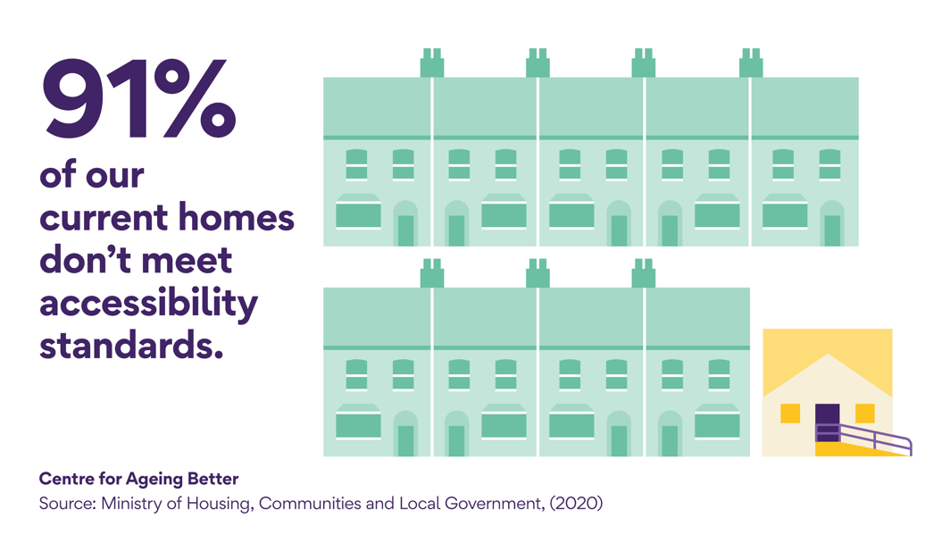
Our housing stock is not ready for the age shift
Notes:
A few key stats about homes in England
Our housing stock is not ready for the age shift that will see the number of households with someone aged over 85 almost double over the next 25 years.
Only 9% of homes in England (just over two million), contain all four basic features that would make them visitable for everyone. These are a WC at entrance level, wide doorways and circulation space, a flush threshold and level access.

Slide 11
Notes:
There is a common misconception that the solution to meeting rising demand for housing among older people is to build more specialist housing, such as retirement villages, sheltered or extra care housing.
While building more specialist housing is certainly a valuable part of the answer, only 5% of over 65s live in specialist housing, with the vast majority of older people living in mainstream housing and 80% wishing to remain in their own homes as they age.
Many view specialist housing as a last resort once they can no longer manage on their own and would prefer to stay in their own homes and communities. We were pleased to see this focus on mainstream housing reflected in the recently published Social Care White Paper.

Slide 12
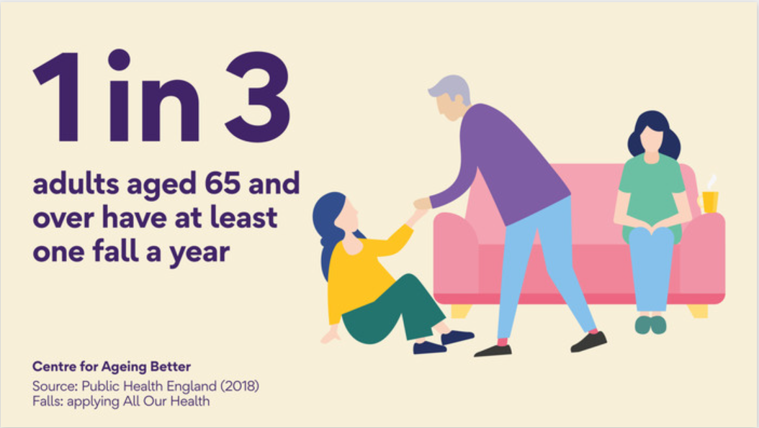
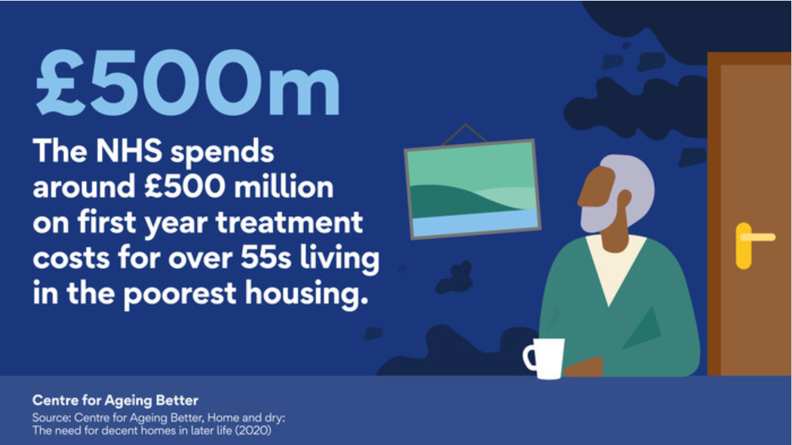
England’s housing stock is in a poor state of repair
Over two million homes headed by someone aged 55 and over do not meet basic standards (e.g. too hot, too cold, trip hazards)
In 2017-18 there were around 220,160 emergency hospital admissions related to falls among people aged 65 and over
Poor housing in England is estimated to cost the NHS £1.4billion a year in treatment bills – more than half of this is due to excess cold, with the second biggest cost coming from falls
Notes:
Our housing stock is in a poor state of repair: There are 3.5 million non-decent homes in England.
The worst performing type of housing in terms of the proportion of non-decent homes is in the private rented sector,
however the highest number of homes classified as non-decent are in the owner-occupier sector.
The social housing sector performs better, with 480,000 non-decent homes out of 4 million (12%). Of the homes headed by someone aged 75 or over, 21% were classed as non-decent in 2017, a proportion that is unchanged since 2012.
There are over two million households headed by someone aged 55 and over which do not meet basic standards: for example, it is too cold, or too damp or has a trip hazard.
In 2017 to 2018 there were around 220,160 emergency hospital admissions related to falls among patients aged 65 and over, with around 146,665 (66.6%) of these patients aged 80 and over falls were the ninth highest cause of disability-adjusted life years (DALYs) in England in 2013 and the leading cause of injury
Poor housing in England is estimated to cost the NHS £1.4billion a year in treatment bills – more than half of this can be attributed to excess cold, while the second biggest cost comes from hazards which cause people to fall and injure themselves. (Building Research Establishment, 2021) Both issues are particularly dangerous for older people and families with young children

Slide 13
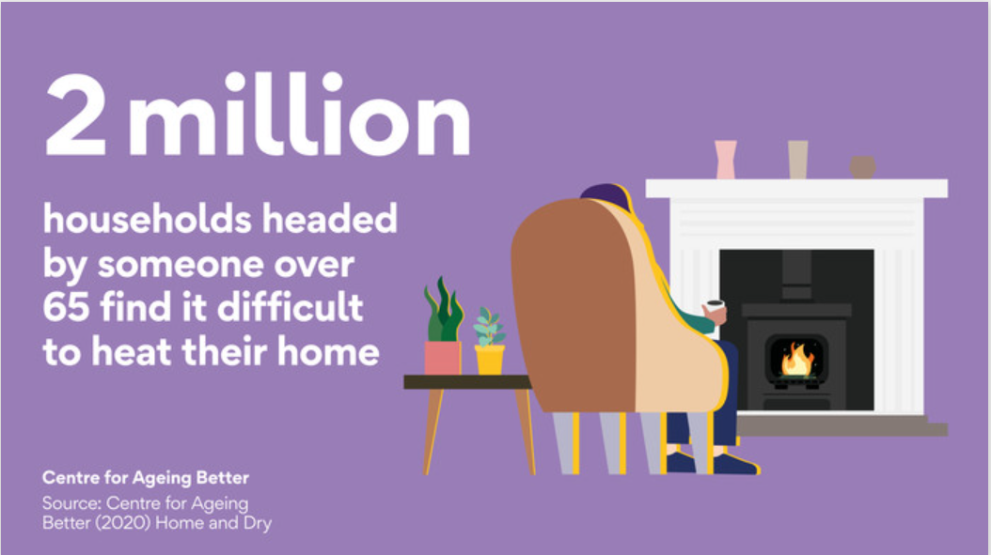
Poverty among those in later life is increasing, as is renting
These changes have profound implications for the financial wellbeing of older people
There are a million more pensioners living in poverty than there were in 2014-15, jeopardising their ability to keep their home warm and safe (latest energy increases especially worrying)
Since 2003 the number of over 55s living in private rented accommodation has more than doubled
The increase is not just because of the age shift, the proportion of older people renting has also increased
Notes:
Poverty among those in and approaching later life is increasing and so is private renting
Significant increase in proportion of older people renting – number has doubled since 2003 – and rising
And the proportion that older renters pay is far higher (up to almost 50% of income – far less for younger)
Cost of living crisis has impact on number of people struggling to heat – (half a million homes are excessively cold / older people going to be spending more) [inflation figures today 11% - older people fixed income / energy costs – over double despite support]
Homes are not ready for climate change. Homes that are too cold or too hot killed 17,000 people in the UK in 2018, with deaths more likely to occur among older groups (E3G, 2018).
The sector plans to invest £70bn by 2050 in improving existing homes, but recent analysis by Savills finds it will cost at least an additional 336bn to reach zero carbon emissions. (NHF, 2021)
Overall, 26 million homes will need to be retrofitted in one way or another between now and 2050 to achieve net zero emissions
These changes have profound implications for the financial wellbeing of older people in the future.
Since 2003, the number of over 55s living in private rented accommodation has more than doubled – a trend which is set to continue. The All Party Parliamentary Group (APPG) on Housing and Care for Older People estimate that there will be an additional 1.5 million households over pension age in the private rental sector by 2045 (making a total of 2.3 million).
This increase is not just because there are more people in this age group now than there were 20 years ago. The proportion of older people in the private rented sector is also rising: 7% of people aged 55 and over were in the private rented sector in 2018-19, compared to 4% in 2003-04.
There are a million more pensioners living in poverty than there were in 2014-15 – a worrying reversal after 15 years of progress. One million owner-occupiers aged 55 or older live in poverty – jeopardising their ability to keep their home warm and safe as they age. Especially worrying in light of increases in the cost of energy.

Slide 14
The Good Home Inquiry
To understand the causes of and solutions to England’s poor-quality housing

Slide 15
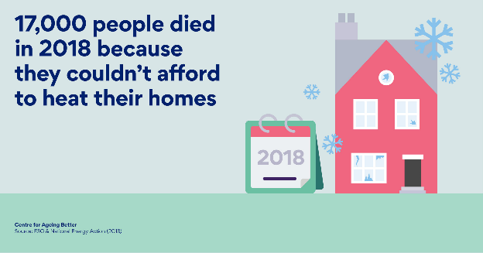
Why do we need the Good Home Inquiry?
Around 10 million people in England currently live in a home that presents a serious threat to their health and safety – defined by the government as ‘non-decent’
Of the 4.1 million non-decent homes, almost half of these are lived in by someone over 55
£1.4 billion cost to NHS from poor quality homes for first-year treatment alone
Notes:
£500m on over 55s first year treatment costs. £1.4bn all population
Health inequalities The COVID-19 pandemic has exposed and amplified housing-related health inequalities
Demographic change One in four of us will be aged over 65 by 2041
Climate crisis Legal obligations from UK government to reach net zero by 2050

Slide 16
Good Home Inquiry
2020 2021
Jul Aug Sep Oct Nov Dec Jan Feb Mar Apr May Jun Jul Aug Sep Oct Nov
Season 1: Homes & Health
Season 2: Environment
Season 3: Finance
Season 4: Digital Connectivity
Final report and dissemination
The King’s Fund report: ‘Homes, health and COVID-19’
Workshop Briefing Webinar
Workshop Briefing Webinar
Workshop Briefing Webinar
Report pre-awareness and launch
CaCHE ‘Past, present and future’ housing policy review and report
Ipsos Mori lived experience study and report
Ipsos Mori poll
Britain Thinks dialogues
Test and learn (e.g Lincolnshire 'Homes for independence' project)
Communications and influencing
Notes:
Views of lots of people with experience of living in unsuitable homes (4,500 research / 100 deliberative research)
Stakeholders in different topic areas – policy makers / professionals
Commissioned 4 x key evidence pieces

Slide 17
Key recommendations
National leadership through a cross-government housing strategy with a ministerial champion to implement it
Local delivery through a ‘Good Home Agency’ in every local area providing access to information and advice, finance, home repairs, energy retrofit services
A combination of government and private investment to develop products to encourage and incentivise homeowners and landlords to improve their homes
Inclusion of housing as a key part of preventative health strategies to improve population health and address health inequalities
Notes:
Improving our homes is a national policy issue, not just an individual issue. There is a need for ownership of the problem and solution at all levels – national oversight, local infrastructure and individual responsibility
No previous government policy interventions have had the long-term strategic approach and funding to make a difference. We need sustainable investment and a long-term approach
Investment and improvement of our homes must be holistic. We must connect repair and improvement to the retrofit strategy
To bridge current gaps, local hubs must effectively reach homeowners and meet their needs
Repairing and improving our housing stock will require a mixture of innovative finance options

Slide 18
Homes
Current work of the Homes Action Area

Slide 19
Age-friendly Homes
We are:
Enabling more home-owners to improve their homes through making the case for Good Home Agencies and exploring financing options
Enabling more older people to live in homes and environments that meet their needs through a ‘Rightplace’ tool for planners and pushing for implementation of accessibility standards

Slide 20
Notes:
Important to note this does not mean the creation of new service but the develop and connecting of existing services – with extra funding from national government
A local hub through which a range of partner organisations and agencies, funding mechanisms, specialist schemes, and wider services can come together to provide a one stop shop for residents and practitioners
Must effectively reach diverse homeowners and residents, helping them to navigate the options that could work for their individual circumstances
Build on existing local infrastructure and effective practice– Home Improvement Agencies could represent a good starting point
Expand the reach of Home Improvement Agencies
Innovative financing: expanding the provision of services further into the ‘able to-pay’ population

Slide 21
The Good Home Agency
Good Home Agency
Evaluation of current home improvement services
Design and testing of new service
Learning network
National and local influencing

Slide 22
Financing - what we know
Finance a key barrier homeowners face (even with means to pay lack of understanding / knowledge / confidence / trust / sense of responsibility)
Comprehensive mix of grants, loans and private funding needed to meet national and individual challenge
Current uncertainty challenging huge investment potential and political will
Pockets of practice / potential for scale

Slide 23
Rightplace
Our research highlights that the neighbourhood within which a person lives is the biggest factor in whether or not they want to stay or move home.
Our evidence shows that it’s a combination of social relationships, services, facilities and accommodation that define our sense of the ‘rightplace’ to grow older.
Plans and housing strategies need to be more responsive to these local and personal circumstances to improve housing choices for people aged 55 and over.
The Rightplace model offers a new person-specific approach to understanding older people’s housing choices – People, Place, Policy. The models allows policy-makers to better understand the needs of older people in different areas through direct engagement with them – and combining this with place-specific data. This approach can be used to support the development of local strategies for rightsizing.

Slide 24
Aims of the coalition
The commitment to raising the accessibility standards to all new homes announced in July 2022 is implemented.
Local Authority housing policies that reflect the needs of older and disabled people
Commitments from housing developers and associations to provide high quality homes fit for the future
Notes:
Pushing for higher mandatory building regulations. Consultation published in September 2020, govt committed in National Disability Strategy to make changes to standards by December 2021 but these still haven’t been announced

Slide 25
Thank you
Natalie.turner@ageing-better.org.uk

Slide 26
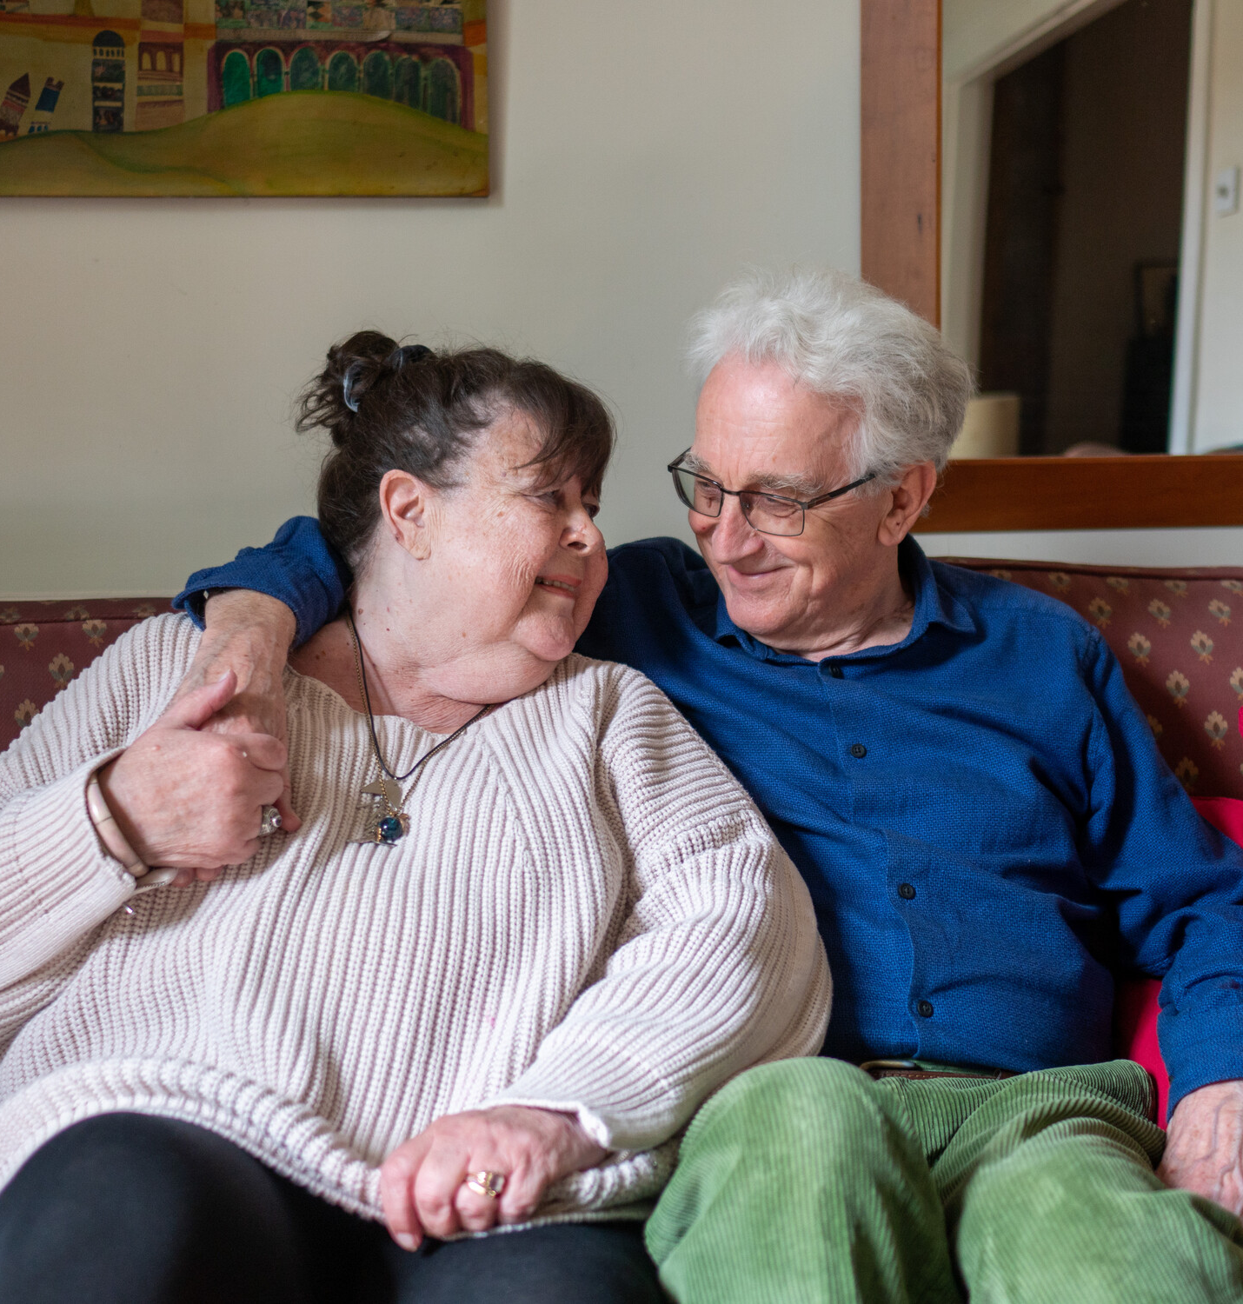
Homes for all ages
People shouldn’t have to change homes just because they’re getting older
New homes must be flexible enough to meet people’s needs
That’s why we’ve helped form the HoME coalition
Around 10 million people live in a home that presents a serious threat to their health and safety.
And people who are poorer, older or disabled are most at risk.
Through the Good Home Inquiry, we explored the causes of and solutions to England’s poor-quality housing.
Notes:
People shouldn’t have to change homes just because they’re getting older,
but too many homes get much harder to live in as we age.
Very few homes have features that help people live independently, like wider doorways - new homes must be flexible enough to meet people’s needs throughout their life.
That’s why we’ve helped form the HoME coalition – we’ve had significant success on this with recent govt announcement that the minimum accessibility standard will be raised for all new homes.
An astonishing 10 million people in England currently live in a home that presents a serious threat to their health and safety.
And people who are poorer, older or disabled are most at risk.
Unsafe homes can be cold, damp, overcrowded or lack the right facilities.
And living in unsafe homes affects people’s mental health too.
Through the Good Home Inquiry, we explored the causes of and solutions to England’s poor-quality housing.
And this again is an area we’ve already begun working on together – we’ll hear more later about the good home alliance development in Lincs.

