Slide 1
UK-South Korea
Ageing in Place Research Network
Age and Cohort-based Measures of Ageing-in-Place:
Understanding Trajectory of Moves and Spatial Distribution of Seniors in South Korea
JungHo Park & Taegyun Yim
Kyung Hee University
Dept. of Housing & Interior Design
BK21 Four AgeTech-Service Convergence Major

Slide 2
Ageing in South Korea

Slide 3
Background
2020 was a demographic and historic turning point in South Korea, which includes
Peak of the total population – around 52 millions – followed by population decline for the first time in Korean history
Baby Boomers’ entrance into 65+ age bracket which accelerates ageing of the population and increases demand for ageing-in-place and age-friendly environment
COVID-19 pandemic has overshadowed and precluded all thinking about the massive demographic shifts and growing needs for ageing-in-place
Still, the concept of ageing-in-place is key to understanding the mechanisms through which seniors age actively in a place where they want to reside

Slide 4
Accelerated Rise of Senior Ratios in S. Korea, 1925 to 2065
Ratio of age 65+ to 0-14
5 to 6 seniors per a kid
(Projected by Korean Census Bureau)
Ratio of age 65+ to 25-64
???
1 senior per 1 economically active age (Projected by Korean Census Bureau)
???

Slide 5
A Century of Age Waves in South Korea : 1955 to 2055
Korean Baby Boomers

Slide 6
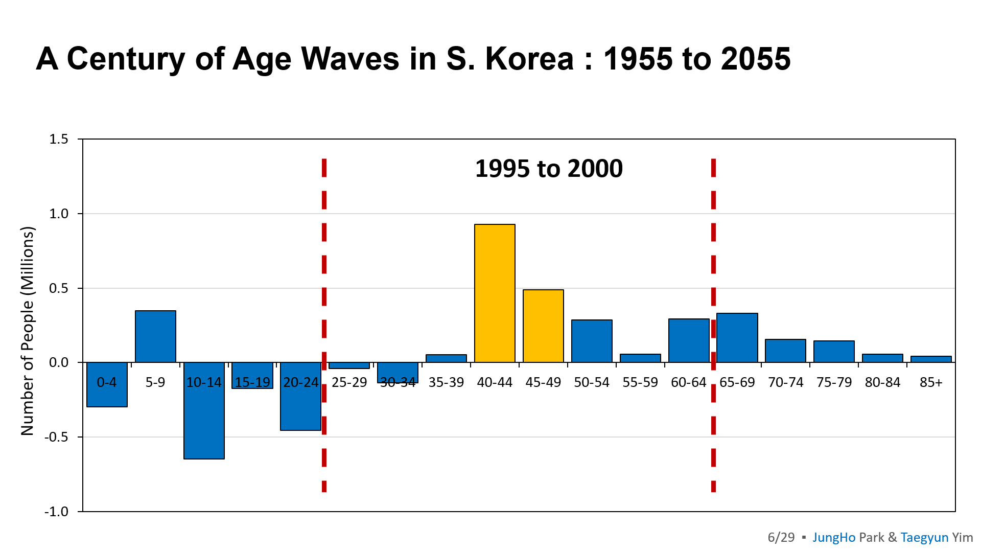
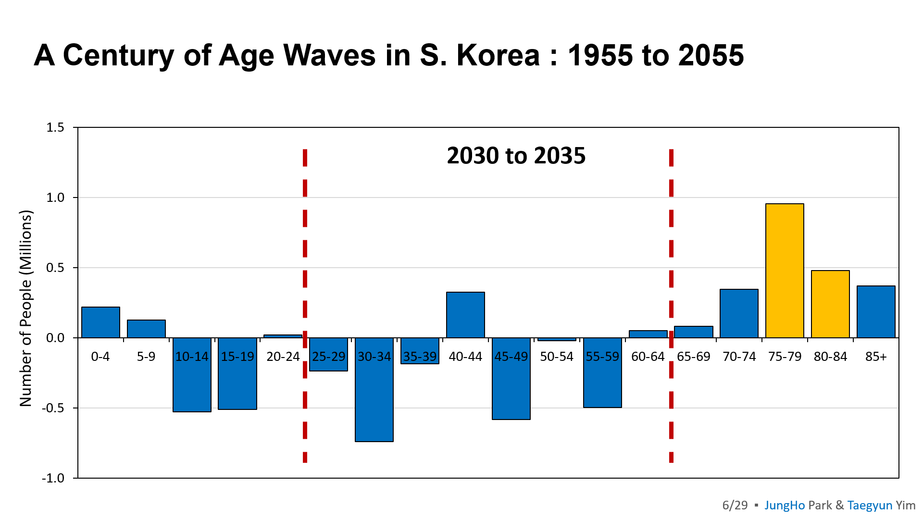
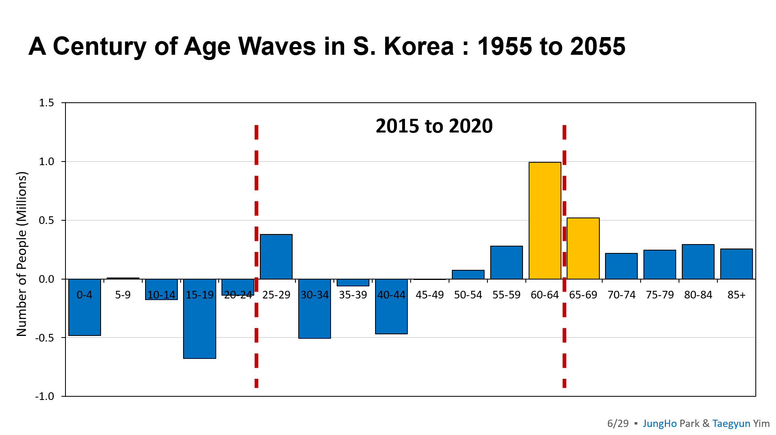
Baby Boomers are Game Changer : Then, Now, and Near Future
Then : economically active while paying tax
Now : retiring & entering senior age bracket (65+)
Future : healthy ageing & receiving welfare benefits

Slide 7
Measuring Ageing in Place
in South Korea

Slide 8
AIP Literature in S. Korea: Either Age Group or Cohort Approach
Reviewing 30+ papers in the fields of ageing, public welfare, demography, housing, & planning
Num. | Cohort vs. Age | Author (Year) | Research Scope |  | Data
 |  |  | Observation Time | Spatial Definition of AIP
1 | Cohort-based Perspective on AIP | Jeong & Lee (2013) | 2005 to 2008 | Nationwide | National Labor Panel
2 |  | Jeong & Lee (2014) | 2003 to 2012 | Nationwide | National Labor Panel
3 |  | Kang & You (2011) | 2008 | Neighborhood | Nation Welfare Panel
4 |  | Park & Kim (2021) | 2009 & 2019 | Large-scale Apartment Complex | National Labor Panel
5 | Age-based Perspective on AIP | Ko & Choi (2014) | 2007 | Nationwide | National Housing Survey
6 |  | Kim et al. (2012) | 2011 | Rural Area | Interview
7 |  | Kwon et al. (2014) | 2012 | Respondents' Subject Recognition | Interview
8 |  | Kim & Seong (2018) | 2013 | Seoul Metropolitan Area | Interview
9 |  | Lee & Park (2015) | 2014 | Respondents' Subject Recognition | Interview
10 |  | Kwon & Kim (2019) | 2014 | Respondents' Subject Recognition | Interview
11 |  | Kim et al. (2015) | 2014 | Respondents' Subject Recognition | Interview
12 |  | Kwon (2015) | 2014 | Seoul & Nearby New Towns | Interview
13 |  | Kim & Kwon (2015) | 2014 | New Towns | Interview
14 |  | Lee (2017) | 2015 | Respondents' Subject Recognition | Interview
15 |  | Park (2019) | 2016 | Respondents' Subject Recognition | Interview
16 |  | Kim & Kim (2021) | 2016 | Seoul | National Migration Survey
17 |  | Jeong & Han (2021) | 2017 | Respondents' Subject Recognition | National Senior Survey
18 |  | Kim & Park (2019) | 2017 | Public Senior Housing Complex | Interview
19 |  | Kang & Kim (2018) | 2017 | Respondents' Subject Recognition | Case Study
20 |  | Kim & Lee (2018) | 2017 | Respondents' Subject Recognition | Case Study
21 |  | Ha & Park (2021) | 2017 | Respondents' Subject Recognition | Interview
22 |  | Yun & Park (2019) | 2017 | Nationwide | National Housing Survey
23 |  | Kim & Lee (2021) | 2018 | Seoul Metropolitan Area | National Housing Survey
24 |  | Hwang (2020) | 2019 | Gyunggi Province | National Migration Survey
25 |  | Lim (2013) | 1998 to 2010 | Nationwide | National Labor Panel
26 |  | Lee & Lee (2010) | 2004 to 2008 | Seoul Metropolitan Area | National Migration Survey
27 |  | Seok (2012) | 2005 to 2010 | Local Small- & Mid-sized Cities | National Migration Survey
28 |  | Shin et al. (2019) | 2005 to 2015 | Seoul | National Migration Survey
29 |  | Song & Jeon (2018) | 2006 & 2016 | Nationwide | National Housing Survey
30 |  | Choi & Choi (2022) | 2016 to 2020 | Busan, Ulsan, & Kyungnam | National Housing Survey

Slide 9
Reconciling Age and Cohort Perspectives on Ageing-in-Place
Age-based literature focus on older ages (65+) and identify places where they age (e.g., staying in place as long as possible, moving but only nearby, and never moving)
Cohort-based studies follow specific birth cohorts (e.g., Baby Boomers) over the life course and compares their intentions to move with actual moving behaviors
Classic approach → LIMITED focus on a specific cohort
Mainly based on survey & interview → LIMITED analysis on nationwide & macro-level AIP
Recent approach → Long-term historical study NOT conducted
Mainly based on panel → Pooled cross-sectional data NOT used yet
①
Age-based
Perspective
on AIP
②
Cohort-based Perspective
on AIP
This
Study

Slide 10
Data and Method: Building Quasi-panel Data from Korean Census
Using Korean Census, this study attempts to build quasi-panel data from pooled cross-sectional Censuses on old age groups and cohorts, which is based on the fact age group and birth cohort are different notions
2010 Census
2020 Census
Indirectly Following Cohorts
(Quasi-panel)
Age 75 to 84
Age 65 to 74
Age 65 to 74
Comparing the Same
Old Age Group

Slide 11
Two Types of Migration Used to Typologize Baby Boomers’ AIP
Two questionnaires relate to migration and residential mobility among old age groups (65+) and Baby Boomers:
Lifetime migration: hometown vs. current place of residence → Do Korean Baby Boomers return back to their hometown?
Recent migration: residence 5 years ago vs. current residence → Do Korean Baby Boomers move as they retire in 50s?

Slide 12
% of Population Living in the Same House as 5 Years Ago

Slide 13
% of Population Living in the Same House as 5 Years Ago
Spotting Baby Boomers
in Each Survey Year
2015
2010
2005
2000

Slide 14
% of Population Living in the Same House as 5 Years Ago
Connecting Baby Boomer Spots

Slide 15
% of Population Living in the Same House as 5 Years Ago
Connecting Baby Boomer Spots

Slide 16
% of Population Living in the Same House as 5 Years Ago
Other Generations Too

Slide 17
Increasing Seniors while Decreasing Baby Boomers in S. Korea
** Recent 5-year Migration in the Nation as a Whole **
Age Measure
Cohort
Measure

Slide 18
Both Seniors & Baby Boomers Increasing in Rural Areas
** Recent 5-year Migration **
Seoul (Urban Area) Similar to the Nation
Jeonbuk (Rural Area)
Age
Measure
Cohort
Measure

Slide 19
17 Largest Cities and Provinces Categorized by 2 Types of Migration
Recent 5-year Migration
Lifetime Migration

Slide 20
Typology of Cities and Provinces Where Boomers Age in Place
 |  | Returning to Hometown (Lifetime Migration)
 |  | Yes | No
Staying Put When Retiring (Recent 5-year Migration) | Yes | Highest Needs for Senior Housing and AIP | Moderate Needs
 | No | Moderate Needs | Lowest Needs

Slide 21
National Spatial Pattern of Baby Boomers’ Ageing-in-Place in South Korea
Dokdo
Highest Needs
Navy blue area: Baby boomers concentrating and their active returns back to hometown
Green area (Seoul): Baby boomers concentrating but not returnees
Purple area: Baby boomers leaving in recent years and no returns to their hometown
21/29 ▪ JungHo Park & Taegyun Yim

Slide 22
Baby Boomers’ Housing Demand
at Old Ages in South Korea

Slide 23
Ageing of Baby Boomers Shifts Stronger Population Growth into Older Age Brackets Key for Growth in Housing Demand
Sustained growth in late 40s and older age groups has continued since 2000 as Korean Baby Boomers age
% Population Growth in Each Period, by Age Group
Source: This slide is based on Dowell Myers’ analysis on the U.S. and California. Publicly accessible at https://scag.ca.gov/33rd-annual-demographic-workshop

Slide 24
Lifecycle Rates of Housing Demand in South Korea
** a Snapshot in 2020 Alone **
Continued Rise of Demand for Owning in Senior Ages
Source: This slide is based on Dowell Myers’ analysis on the U.S. and California. Publicly accessible at https://scag.ca.gov/33rd-annual-demographic-workshop

Slide 25
Active Rates of Housing Demand at Each Point in the Lifecycle
** Net Increases in Cohorts as they Grow Older **
Housing status changes per 100 people in South Korea of each age
Source: This slide is based on Dowell Myers’ analysis on the U.S. and California. Publicly accessible at https://scag.ca.gov/33rd-annual-demographic-workshop

Slide 26
Discussions and Next Steps
Trends of ageing-in-place in S. Korea may be seen differently depending on age vs. cohort perspective → Examine other age groups and cohorts
Typology of 17 cities and provinces shows spatial distribution of future needs for senior housing and AIP → Analyze smaller areas (communities)
Ever increasing and changing housing demand at older ages → Consider housing variables (e.g., tenure, structure type) available in Korea Census
What about the U.K. case? How baby boomers (or other cohorts) in U.K. have fared in terms of ageing in place? → Explore U.K. Census data

Slide 27
Key References
Forsyth, A., & Molinsky, J. (2021). What Is Aging in Place? Confusions and Contradictions. Housing Policy Debate, 31(2), 181–196.
Wiseman, R. F. (1980). Why Older People Move: Theoretical Issues. Research on Ageing, 2(2), 141–154.
강희선. (2017). 에이징 인 플레이스(Aging in Place) 개념을 고려한 공공임대아파트 커뮤니티시설의 노인공간 계획. 한국주거학회논문집, 28(4), 55–63.
정현원 & 오정아. (2016). 노년층의 에이징 인 플레이스 주거 디자인을 위한 아파트 커뮤니티 시설 현황 분석에 관한 연구. 상품문화디자인학연구, 46, 115–127.
Hyunjeong, L. (2011). Rediscovering A Path to Aging in Place. Architectural Research, 13(3), 31–40.
Kang, M.-C., & Kim, Y.-H. (2017). An Analysis of Urban Preference in Urban type Elderly Housing in Aging in Place. 한국생태환경건축학회 논문집, 17(5), 5–14.
Seong, S.-Y., Yang, J.-S., & Nam, J. (2021). A Study on the Socio-spatial Characteristics of the Elderly and the Influence Factors of ‘Aging in Place’ in Seoul: With a Focus on Elderly-concentrated Areas. 국토계획, 56(7), 5–25.
권오정, 김진영. (2019). 장노년층의 Aging in Place 의사 여부와 이에 따른 관련 변인 특성 차이. 한국주거학회논문집, 30(3), 77–85.
권현주, 이수진, & 이연숙. (2008). Aging-in-Place를 지원하는 고령친화 디지털홈 계획방향 요구에 대한 실험적 연구. 대한건축학회 논문집 - 계획계, 24(7), 21–28.
김미란 & 이경훈. (2018). 노인의 AGING IN PLACE 증진을 위한 종합지원센터 도입 필요성에 관한 연구. 대한건축학회 논문집 - 계획계, 34(5), 51–60.
김수영, 문경주, & 오찬옥. (2015). 고령화 지역의 Aging in Place에 영향을 주는 조건분석을 통한 정책방향 탐색. 지역사회연구, 23(2), 137–164.

Slide 28
(Continued) Key References
김혜신 & 박수빈. (2019). 지속적 거주(Aging in place)를 위한 국내·외 주택설계지침의 비교. 대한건축학회 논문집 - 계획계, 35(9), 19–28.
김희경. (2016). 노년의 장소와 장소상실. 비교문화연구, 22(2), 259–289.
심성호. (2019). Aging in Place 지원을 위한 스마트 홈 서비스 시스템 설계에 관한 연구. 디지털융복합연구, 17(12), 249–254.
오찬옥. (2008). 그룹 홈과 공유주택 개념을 중심으로 본 Aging in Place를 위한 노인주거대안 개발을 위한 연구. 한국주거학회논문집, 19(3), 59–70.
우국희. (2017). 섬 지역 고령자의 장소경험과 의미. 비판사회정책, 54, 260–304.
이경욱. (2020). 도농복합시 지역주민이 인식한 ‘살던 곳에서 계속 살기(Aging in Place)’ 실태 연구. 독서치료연구, 12(2), 123–144.
이수진, 권현주, 이연숙, & 민병아. (2007). Aging in Place를 지원해주는 유니버설디자인 욕실설비 및 제품 특성 분석연구. 대한건축학회 논문집 - 계획계, 23(12), 125–134.
이승훈. (2017). AIP(Aging in Place)에 대한 주관적 기대와 의미. 공공사회연구, 7(1), 135–163.
이현진 & 박재승. (2010). Aging in Place를 위한 노인주거시설 선호에 관한 연구. 의료·복지 건축(구 한국의료복지시설학회지), 16(1), 55–63.
임연옥. (2016). 친숙한 지역사회에서 존엄하게 늙어가는 것은 어떻게 가능할까? 노인복지연구, 71(3), 411–436.
정수이 & 민현준. (2016). ‘Aging In Place’의 측면에서 도시 노인주거시설의 커뮤니티 공간 연구. 한국문화공간건축학회논문집, 54, 97–104.
조인숙, 박남희, & 신화경. (2007). Aging in Place를 위한 재가노인복지서비스에 관한 연구. 한국주거학회논문집, 18(1), 95–102.
판단단 & 김세화. (2020). 중국 구도심지역 노인 생활관찰을 통한 Aging in Place 수요항목 조사연구. 기초조형학연구, 21(1), 557–570.
홍송이. (2017). Aging-in-Place를 위한 노인복지정책의 비판적 이해: 싱가포르 사례연구. 사회과학연구, 43(1), 227–254.

Slide 29
UK-South Korea
Ageing in Place Research Network
Thank you
JungHo Park & Taegyun Yim
Kyung Hee University
Dept. of Housing & Interior Design
BK21 Four AgeTech-Service Convergence Major
JungHo’s email : jhpark.planner@khu.ac.kr jhpark.planner@gmail.com

