Slide 1
Financial Support, Practical Help, and Residential Choices of the Elderly: Evidence from South Korea Jae Sik Jeon and Bo Seon Jung
Jae Sik Jeon
Assistant Professor, Real Estate Studies, Konkuk University, South Korea
ESRC UK-South Korea Ageing in Place Research Network Workshop
14th November 2022

Slide 2
Contents
Backgrounds
Literature Review
The Gap in the Literature
Research Questions
Data
Methods
Results
Findings
What's Next
2

Slide 3
Backgrounds
In South Korea, housing supply for the elderly has not kept paced with aging population.
Established in 1981 and amended in 2015, the Welfare of Senior Citizens Act has shifted to permit rental development projects only due the following issues
Ownership units were illegally sold or leased to ineligible, non-elderly households.
Essential community services were inadequately provided after developers or investors exited from the project.
3

Slide 4
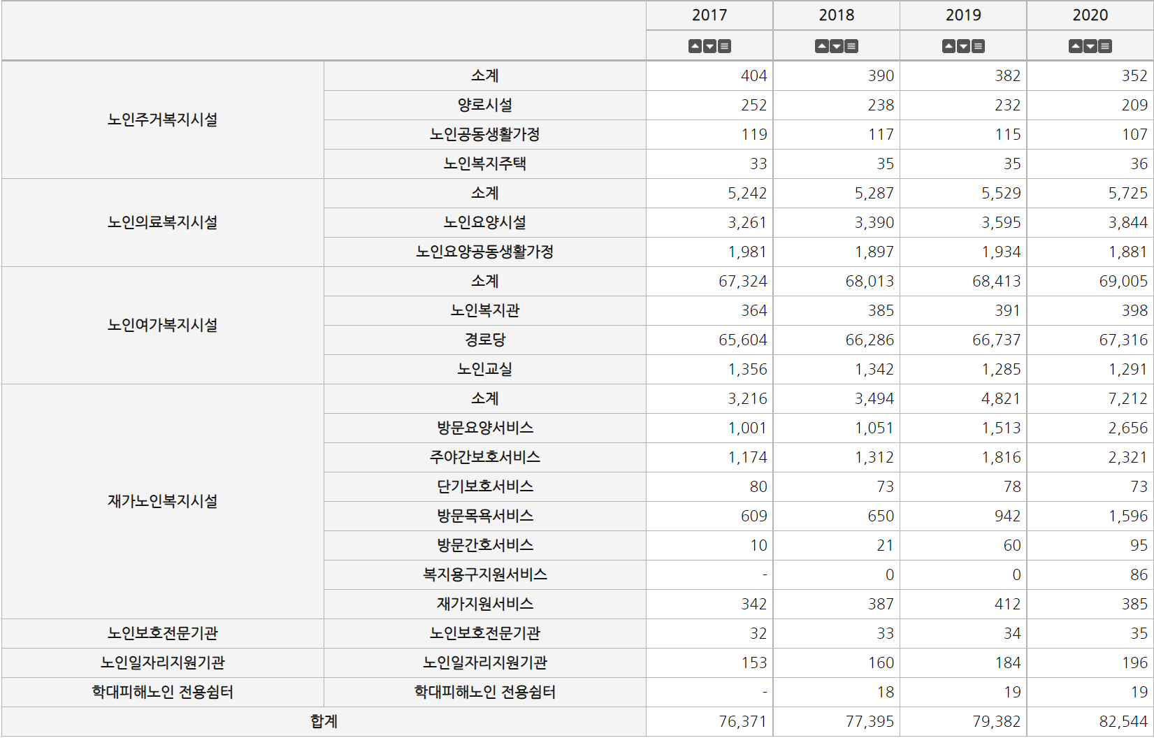
Backgrounds
Sub Total
Senior Living Facilities
Senior Housing
Senior Share Housing
Senior Welfare Housing
Sub Total
Senior Health Facilities
Nursing Homes
Senior Community Housing Sanitarium
Sub Total
Senior Leisure Facilities
Senior Welfare Center
Senior Club
Classes for Elderly
Sub Total
Home Health Care Service
Day and Night Care Service
Senior Home Care Services
Short Term Care Service
Assisted Bath Service
Visiting Nurse Service
Welfare Tool Support Service
Community Care for Elderly
Senior Protection Agency
Senior Protection Agency
Senior Labor Development Center
Senior Labor Development Center
Shelter for Abuse Victims
Shelter for Abuse Victims
x
Total
4

Slide 5
Backgrounds
Corporations, school foundations, hospitals, and religious organizations are developers/operators.
5

Slide 6
Literature Review
Why do people move?
Optimal equilibrium
Residential mobility can be viewed to bridge the gap between one’s desired housing bundle and the actual bundle consumed
Life-course perspective
6

Slide 7
Literature Review
Mobility decisions within the context of social relations
Informal channels of trust and repeated local social interaction
Useful in accomplishing shared goals
(e.g. keeping the street safe)
Informational context in the geography of opportunity literature
Filter information -> form individuals’ subjective perceptions of the metropolitan opportunity structure
(e.g. institutional health services)
7

Slide 8
Literature Review
Strong social ties often deter residential mobility
Mixed reasons for staying close to kin, friends, or neighbors
Emotional support and practical help -> Resources for social services
Obligations -> Burdens on household resources
Proximity to kin enables seniors to remain in their own homes, in other words, aging in place.
Residential instability may occur if children live far away from the parent’s home.
8

Slide 9
Literature Review
Migration patterns among the elderly
The first move
Typical of migrants at this first stage would be those moving to retirement communities or to non-metropolitan small-town settings.
Such migrants will tend to be younger, healthier, wealthier, and more often to have intact marriages.
The poorer retiree often cannot afford to make such a move for the sake of amenities and life-style considerations.
Kinship functions can be managed over considerable distances
Retirees move closer to their children or other relatives, but when their health declines, the nearness of their children may preclude the necessity of a second move.
9

Slide 10
Literature Review
Migration patterns among the elderly
The second move
The pressure for the second move occurs when older people develop chronic disabilities that make it difficult to carry out everyday household tasks.
If older people live at a distance from their child's home, they need to move toward children when they become disabled and widowed.
Children produces the internalized commitments necessary for providing household service.
Formal institutions are essential for those older people who are severely disabled, or who do not have children they can count on, or whose children are overburdened.
10

Slide 11
Literature Review
Migration patterns among the elderly
The third move
Limited kin resources is the motive for the third basic move.
When the older person becomes severely ill, he or she must move away from the immediate neighborhood of the child-helper to an institutional setting.
It must be an institutional setting where the child can maintain regular contact and provide meaningful services to the older person.
Most third-stage moves are local rather than long-distance moves.
This move may not occur for some. Some continue to be cared for by their children until they suddenly die.
11

Slide 12
The Gap in the Literature
Despite the growing evidence of the link between social capital and residential decisions of the elderly, a few studies to date have examined the dynamics of financial support and practical help as determinants of housing choice.
Little is known about whether financial transfers or practical help from children to parents is likely to promote aging in place or whether intergenerational support from parents to children tends to make seniors move away from their community unintentionally.
12

Slide 13
Research Questions
How do practical help and financial transfers from children affect the likelihood of aging in place?
What is the effect of financial or practical support from parents to children on residential mobility of senior households?
13

Slide 14
Data
Korean Longitudinal Study of Aging
The purpose of KLoSA is to create the basic data needed to devise and implement effective social, economic policies to address the trends that emerge in the process of population aging.
Survey subjects are middle/old-aged population (45 or older) nationwide, excluding Jeju Island.
The sample size is about 10,000 households.
Biannual survey
14

Slide 15
Data
Our research focuses on
Seven survey results (2008 – 2020)
Specific households
65 or older
1 or more children
Don’t live with children
Only households who moved to other neighborhoods are considered as movers.
Moves within the existing neighborhood are dropped.
Intended to capture the move to retirement communities, to non-metropolitan small-town settings, or to nursing homes
15

Slide 16
Methods
Logistic regression model
Dependent variable: 1 if moved (1st move only)
Independent variables:
Age
Male
Married
Severely Ill
Retired
Apartment
Location (1=rural, 2=small metropolitan areas, 3= large metropolitan areas)
Wealth (Unit: ₩10,000,000, Inflation-adjusted)
Practical Help from Children to Parents
Practical Help from Parents to Children
Financial Support from Children to Parents (log-transformed)
Financial Support from Parents to Children (log-transformed)
16

Slide 17
Methods
Item Response Theory estimation
Estimated standardized score based on a range of conceptually related questions
Practical Help from Children to Parents
Have at least one child who lives nearby (30 minutes or less)
Have at least one child who meets with one or more times per week
Practical Help from Parents to Children
Have experience with taking care of grandchildren over the past year
Have a parent or a child whom you assist in everyday household tasks
The higher the score, the greater the dependence.
17

Slide 18
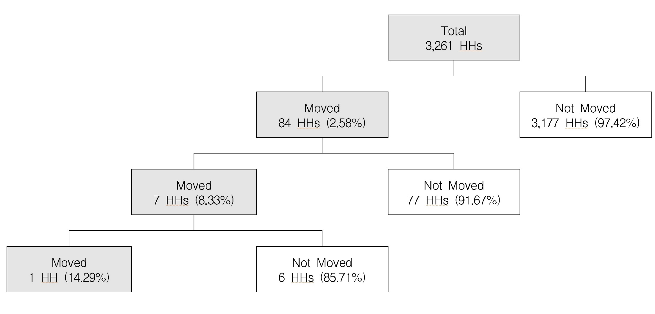
Results
18

Slide 19
Results
Variable | Coefficient
Age | -0.010
Male | -0.187
Married | -0.203
Severely Ill | 0.829***
Retired | 0.014
Apartment | 0.973***
Location | 0.722***
Wealth | -0.018**
Practical Help from Children to Parents | -0.419**
Practical Help from Parents to Children | 0.215
Financial Support from Children to Parents | 0.008
Financial Support from Parents to Children | -0.008
constant | -3.423*
Number of obs | 791
LR chi2(12) | 39.62***
Pseudo R2 | 0.0901
19

Slide 20
Findings
Senior households live in in an apartment unit in urban areas are more likely to move.
Consistent with the previous finding of the first move
Movers tend to move to non-metropolitan small-town settings.
Senior households with a severe ill health condition are more likely to move.
Consistent with the previous finding of the second move
It occurs when older people develop chronic disabilities.
Likely to moving to nursing homes (or moving closer to children or to institutional services)
20

Slide 21
Findings
Wealthier households are less likely to move.
Inconsistent with the previous finding of the first move
The first movers tend to be younger, healthier, wealthier, and more often to have intact marriages.
This may be due to the lack of senior housing options (retirement communities).
The existing home may not be adequately equipped with an accessible living environment.
21

Slide 22
Findings
Senior households who receive more practical help from children are less likely to move.
Consistent with the previous finding of the first move
When health declines, the nearness of their children may preclude the necessity of a second move.
Children produces the internalized commitments necessary for providing household service.
Insignificant results of financial support
Financial support from parents to children may be associated with practical help from children to parents.
Financial support from children to parents may be linked to the move to nursing homes.
22

Slide 23
What’s Next
Modify variables and re-run the model
Develop the competing risk models for the first and second moves
Can this research be applied to the UK case?
How do the migration patterns of the elderly differ from Korea?
Data availability
23

Slide 24
Thank You
jaesikjeon@konkuk.ac.kr

