Slide 1
Greater Manchester Ageing Hub
Paul McGarry
Head, GM Ageing Hub/Assistant Director, GMCA

Slide 2
Overview
1
About Greater Manchester
Our strategy for an ageing population
Programme highlights
2
3

Slide 3
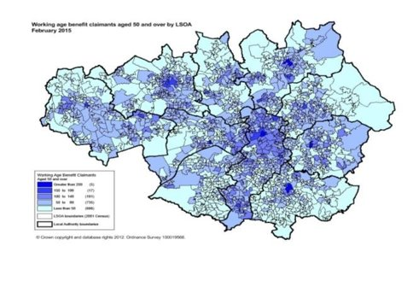
Greater Manchester – overview​
2.8m people across 10 localities
WHO age friendly city region
Elected mayor
Devolved powers
£64bn economy
100k students
124k businesses
1 Greater Manchester Ageing Hub

Slide 4
Greater Manchester Ageing Hub
Set up 2016 by GMCA with partners
Partnership of organisations working to improve the lives of residents as we age.
WHO age friendly city model
Work with 10 Greater Manchester local authorities
National partnerships - Centre for Ageing Better + Independent Age
International partnerships - Eurocities

Slide 5
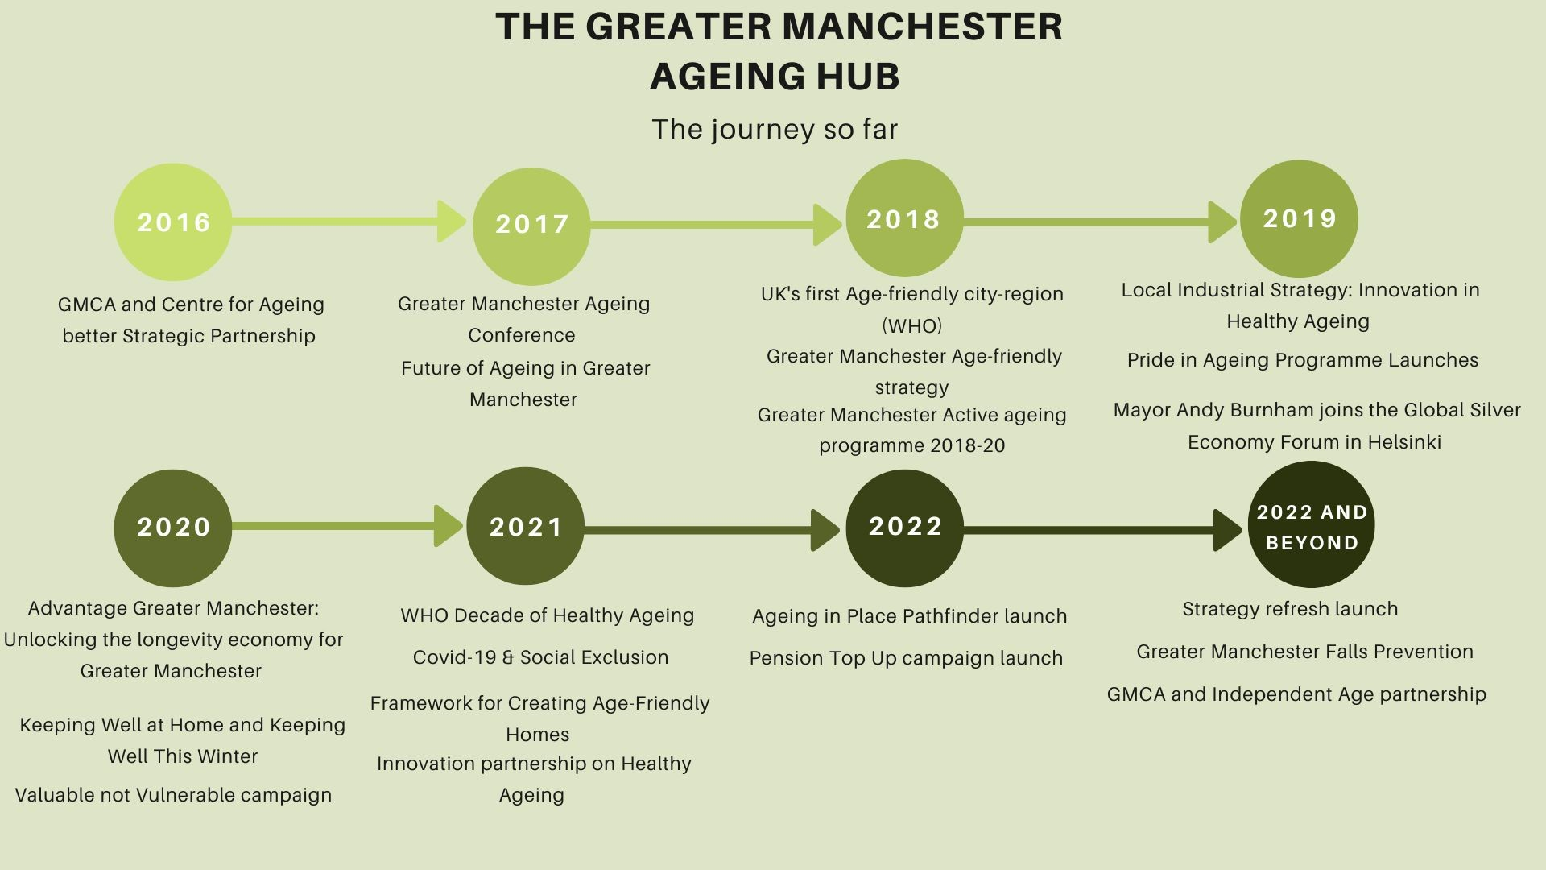

Slide 7
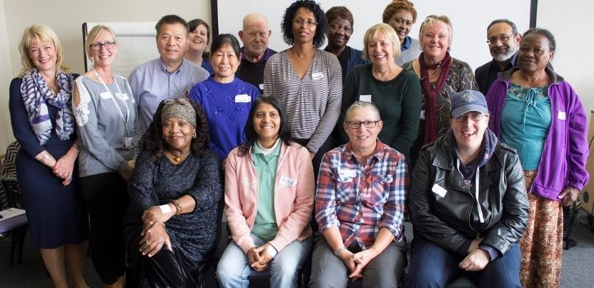
Ways of working
Political and senior support
Eco-system – social movement
Narrative building
Making ageing relevant
Research – policy -
practice
Voice of older people
Inequalities
Long-haul – present to future

Slide 8
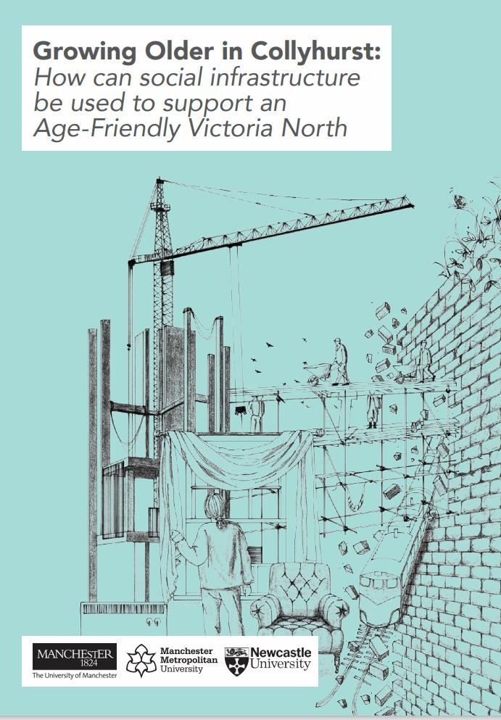
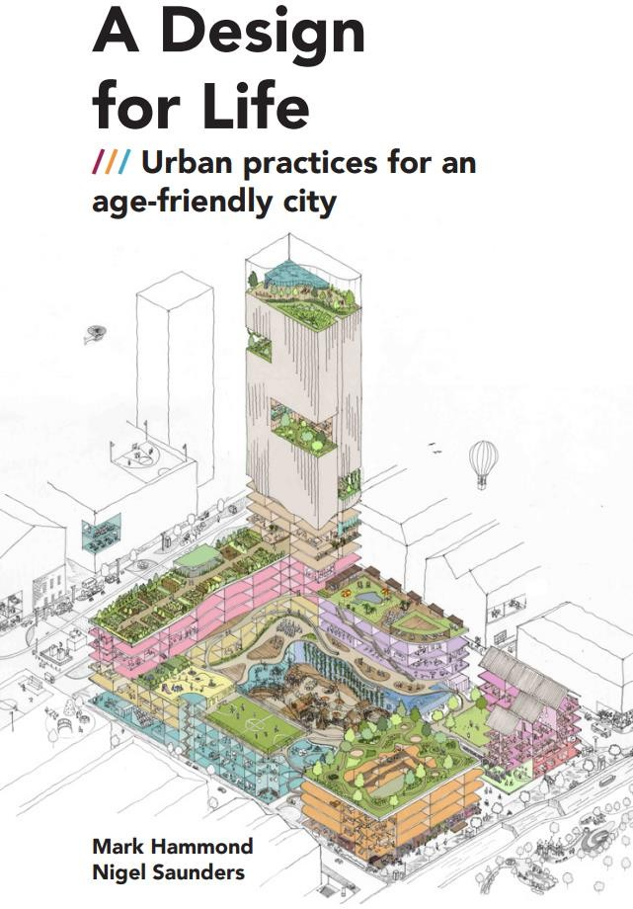
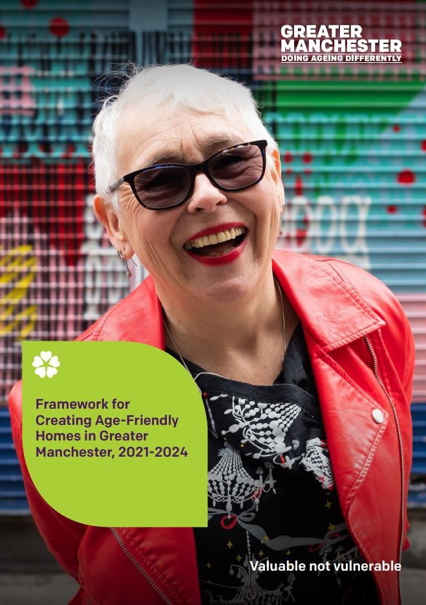
Designing for and with ageing populations

Slide 9
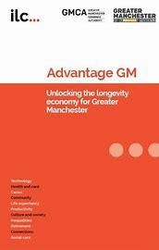
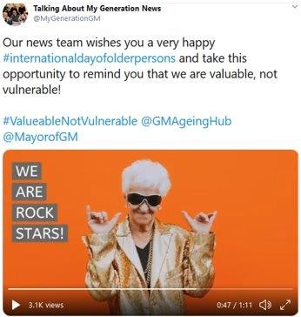
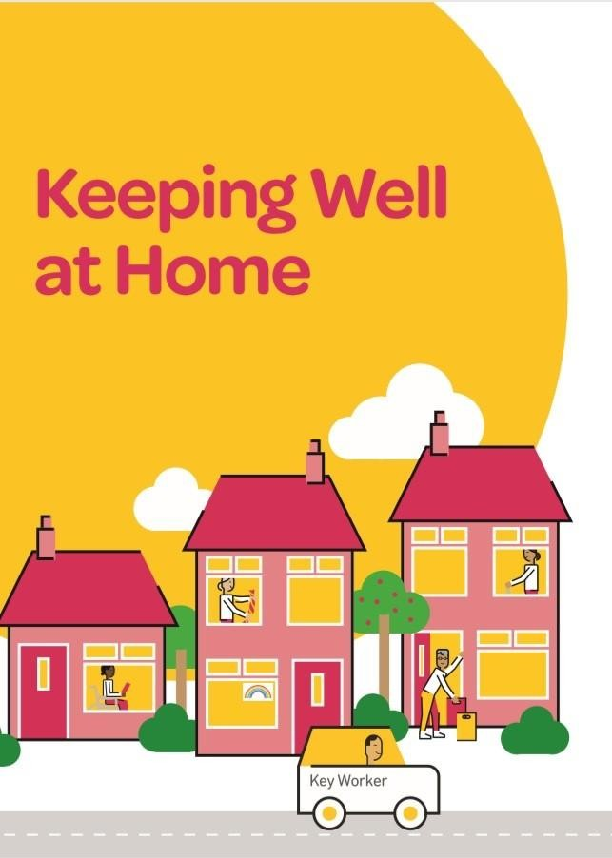
Programme highlights
Work and skills
Ageing in Place
Housing and Planning
Innovation and growth
Ageing Well
Digital inclusion
Covid
Cost of living

Slide 10
2022 strategy overview ​
Our four commitments:
​
Work together to grow our age-friendly movement and deliver system wide change​
Improve financial security in later life and realise the contribution ageing brings to economic growth in the city region.​
Develop and scale approaches to ageing in place for all older people to thrive in the places they live.​
A shift towards prevention creating the conditions and support for people to age well through healthy, active & connected lives.

Slide 11
Ageing in Place Pathfinder
4-year £4 million investment (£2 million philanthropic) 4-year programme (April 2022-March 2026)
Based in Naturally Occurring Retirement Communities model
8 neighbourhood-based Pathfinder Partnerships
Greater Manchester Combined Authority & partners
Part of the GM Age-Friendly Strategy commitment:
Develop and scale approaches to ageing in place for all older people to thrive in the places they live.
Ageing in Place Pathfinder, Greater Manchester
Notes:
Notes:
- Total £4 million investment (100% matched) – local Partnerships & Greater Manchester agencies)
- Bid based in Naturally Occurring Retirement Communities concept (not previously used at scale in UK)
- 8 neighbourhoods – human scale, various sizes
Partnership Leads – further detail on the next slide, majority Housing Providers, then Local Authority and 1 VCS
Partnerships
Little Lever, Bolton – Bolton at Home
Moorside, Bury – Bury Council
Abbey Hey, Manchester – Southway Housing
Kirkholt & Smallbridge, Rochdale – Rochdale Borough Housing
Pendelton & Charlestown, Salford – Inspiring Communities
Brinnington, Stockport – Stockport Homes
Ridgehill & Stalybridge, Tameside – Jigsaw
South Wigan, Wigan – Wigan Council

Slide 12
Why Ageing in Place Pathfinder?
Demography of Greater Manchester is changing due to population ageing
16% residents are now over-65, based on current population estimates, this group will surpass the number of under-15s by 2031.
Ageing is changing: more people living alone, rising diagnoses of dementia & depression
Nationally 12.9% all households are one person households with residents aged 66 years or over (2021 census)
Link single person households at greater risk of social isolation & poor access to services
We are not ageing equally with other parts of the UK, or within Greater Manchester and deprivation impacting on outcomes
Average life expectancy for men in over 65s is 17.5, below national avg of 18.7; female HLE GM avg is 19.8, nationally 21.1
3.92 years difference between life expectancy for men in Trafford (80.3) and Manchester (76.38); for women 3.63 years (83.91 & 80.28)
Impact of Covid-19: long-Covid, deconditioning & social isolation
One-third fewer older people using the concessionary travel pass & one-third fewer trips than pre-pandemic
Cost of Living Crisis is exacerbating poverty and deprivation for older people
The places in which people are ageing may offer inadequate support e.g.,
Lack community infrastructure, impact of austerity
Services can be fragmented and with the pressure of increased waiting times, remain reactive rather than preventative.
Access to support may be random rather than consistent and predictable, vary according to the strength of neighbourhood networks, and links with community organisations
Communities can change in ways which may threaten independence, e.g., impact of gentrification and urban regeneration
Transitions in later life may undermine people’s engagement with their community, e.g., through loss of a partner, long-term illness
Age-friendly communities have developed good practice but how to sustain & scale is unclear
Ageing in Place Pathfinder: Induction Session
Notes:
What's the problem we are trying to solve?

Slide 13
Experiences of strong and supportive neighbourhoods are the most important contributor to good well-being in later life: “Health status is less important for well-being for those who think they are in charge of their environment, who perceive their neighbourhoods as more cohesive and who report higher identification with their district.” (Oswald and Konopik, 2015)
Ageing in Place Pathfinder, Greater Manchester

Slide 14
Key features of the Pathfinder Partnerships
Based in a co-production approach that promotes Ageing in Place by:
Engaging older citizens in their communities (over 50s)
Place specific linking individual needs with communities and transforming communities into supportive places to live
Supported by a lead accountable agency in the place
Building new relationships & partnerships between older people and local public, VCSE and private organisations
Identifying pro-active & preventative responses that anticipate issues
Facilitating new and adapted activities / services
Interconnected - using the WHO 8 domains to identify and address barriers to well-being and participation
Outdoor Space and Buildings
Transportation
Communication
& Information
Housing
Community Support
& Health
Social
Participation
Civic Participation
& Employment
Respect &
Social Inclusion
WHO Age-friendly Cities Framework
Ageing in Place Pathfinder, Greater Manchester

Slide 15
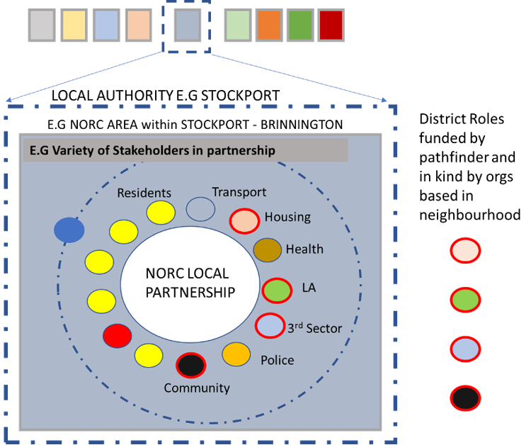
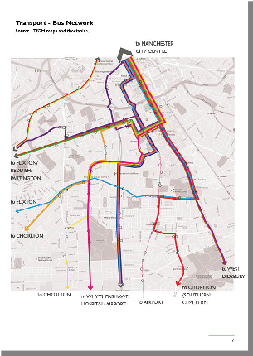
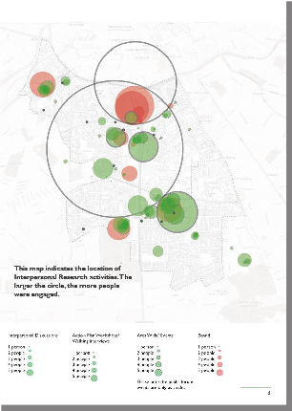
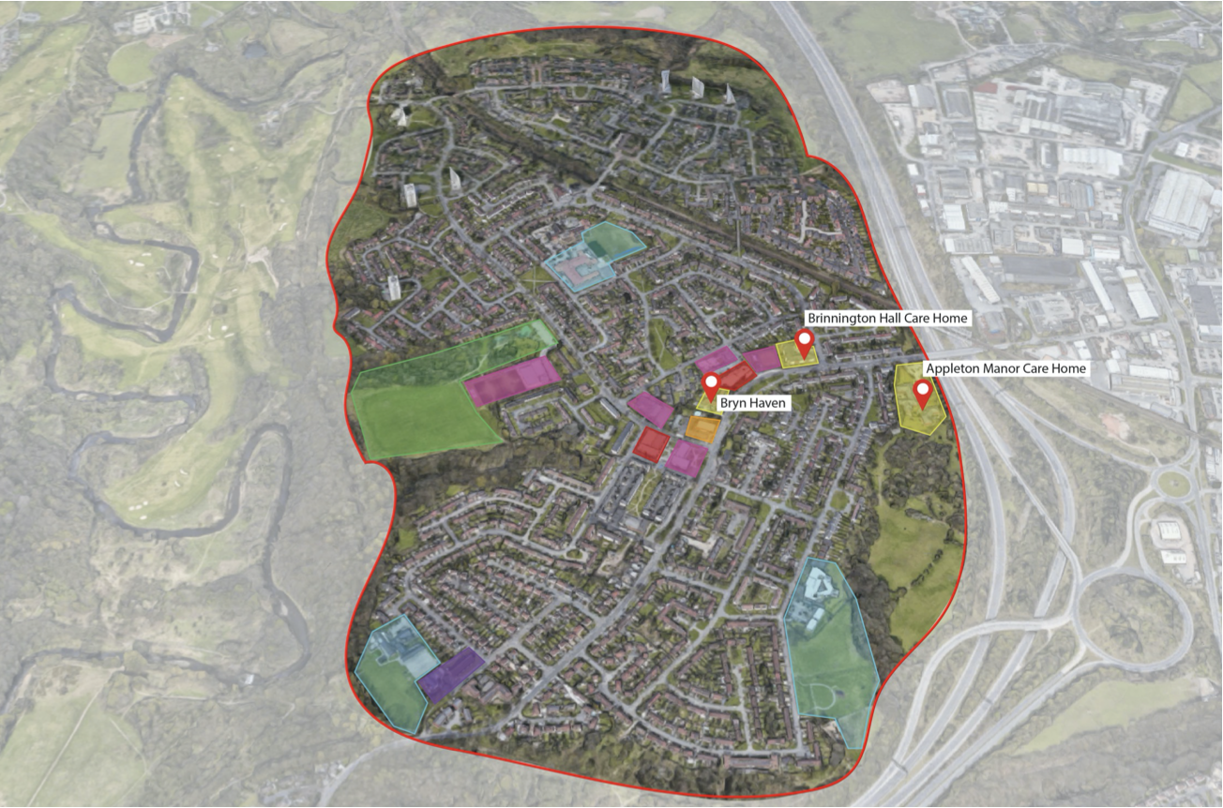
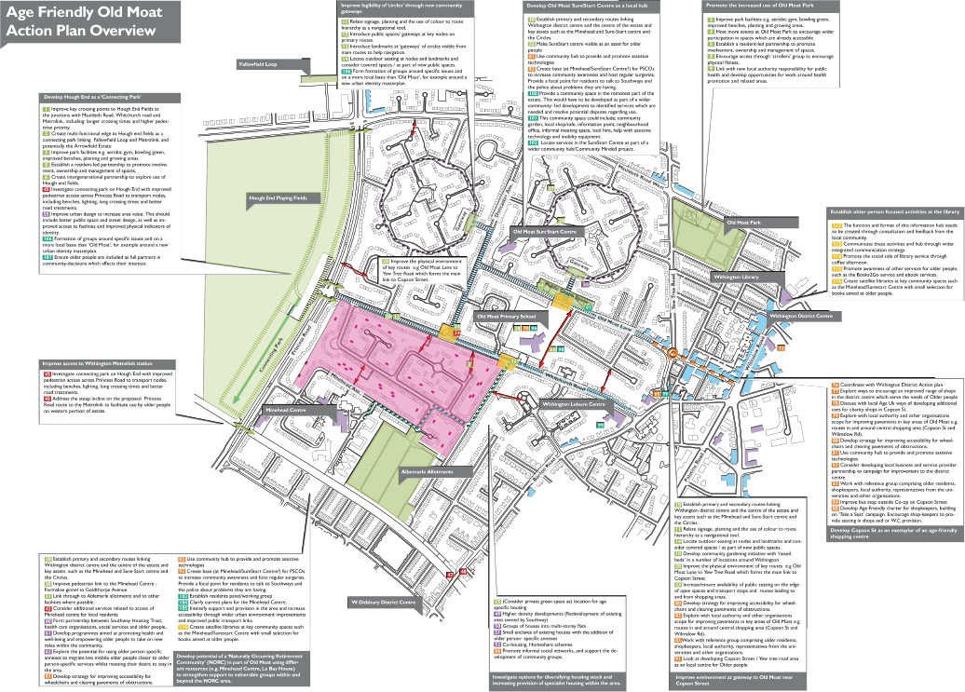
Co-produced action planning in place
Spatial Data
Asset mapping
Recruitment & Engagement
Resident-led Partnership Board
What's it like to live here?
50% local residents;
50% over 50 years
SPATIAL
DATA
PHYSICAL
ENVIRONMENT
ENGAGEMENT
EVENTS
How can we make it better?
Would you like to join us?
ACTION PLAN
Ageing in Place Pathfinder, Greater Manchester

Slide 16
Greater Manchester Ageing Hub
Twitter: @GMAgeingHub
Email: ageinghub@greatermanchester-ca.gov.uk
Visit: www.greatermanchester-ca.gov.uk/what-we-do/ageing

