Slide 1
Shifts in health expenditure over the period of
pre- and post-COVID-19 pandemic
Dr. Jihwan Kim,
Assistant Professor in Urban Economics and Data Science,
College of Business and Economics, Hanyang University ERICA

Slide 2
Summary
An exploratory research to investigate shifts in health expenditure by the elderly
over the study period
We utilize credit card microdata for Exploratory Data Analysis (EDA) as well as
Clustering of card holders
We’ll shift our focus toward shedding light on channels and mechanics of
such dynamics and shifts

Slide 3
Data
Data comprehensiveness
Data provided by Samsung Card, which is the 2nd largest credit card company in Korea, Republic of, with a 18.5% market share as of 2021
Our credit card microdata includes over 0.11 B observations (113,272,657) over the period of 2015 to 2021

Slide 4
Data
Data granularity
Our data includes key features of (de-identified) credit card holders, such as address, sex, age, income, and occupation, and their detailed monthly expenditures

Slide 5
Exploratory Data Analysis
Summary statistics by age and other key demographic features

Slide 6
Exploratory Data Analysis
Monthly total expenditures per capita
Spending (number): (avg) 13.94, (min) 0, (max) 456
Spending (volume): (avg) 671K KRW, (min) 0 KRW, (max) 127M KRW
Amount Per Consumption (ApC): (avg) 74K KRW/C, (min) 0 KRW/C, (max) 99M KRW/C
Monthly health expenditures per capita
Spending (number): (avg) 0.88, (min) 0, (max) 101
Spending (volume): (avg) 51K KRW, (min) 0 KRW, (max) 13M KRW
Amount Per Consumption (ApC): (avg) 22K KRW/C, (min) 0 KRW/C, (max) 7.7M KRW/C

Slide 7
Exploratory Data Analysis
[By Age & Sex] male expenditures significantly increase with age,
even though the sex ratio commonly tends to decrease over the life course

Slide 8
Exploratory Data Analysis
[By Age & Income] individual income becomes noticeably volatile for age groups of 60s+, as they typically remain at work before age 60

Slide 9
Exploratory Data Analysis
[By Age & Occupation] % self-employed has played a significant role for all age cohorts,
an evidence of inadequate social protection

Slide 10
Exploratory Data Analysis
Shifts in health expenditures during the period of pre- and post-COVID-19 pandemic

Slide 11
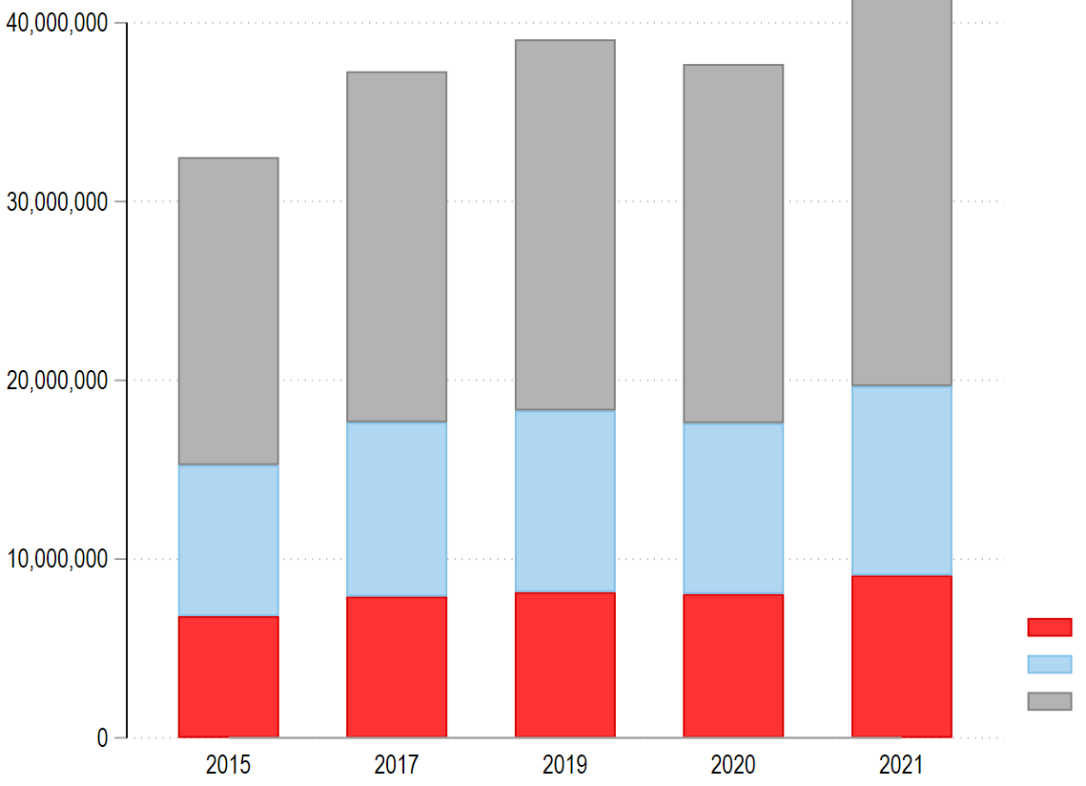
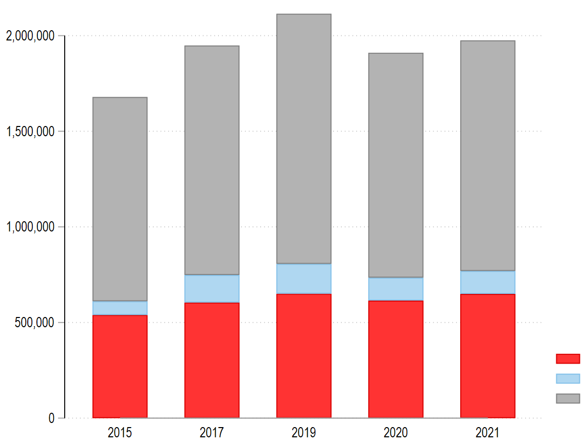
Exploratory Data Analysis
Health spendings significantly dropped and have not recovered from the COVID-19 shock, even though total expenditures have gradually been growing over the period
Total Expenditures (KRW)
Health Expenditures (KRW)
Top 10%
Top 25%
Top 50%
Top 10%
Top 25%
Top 50%

Slide 12
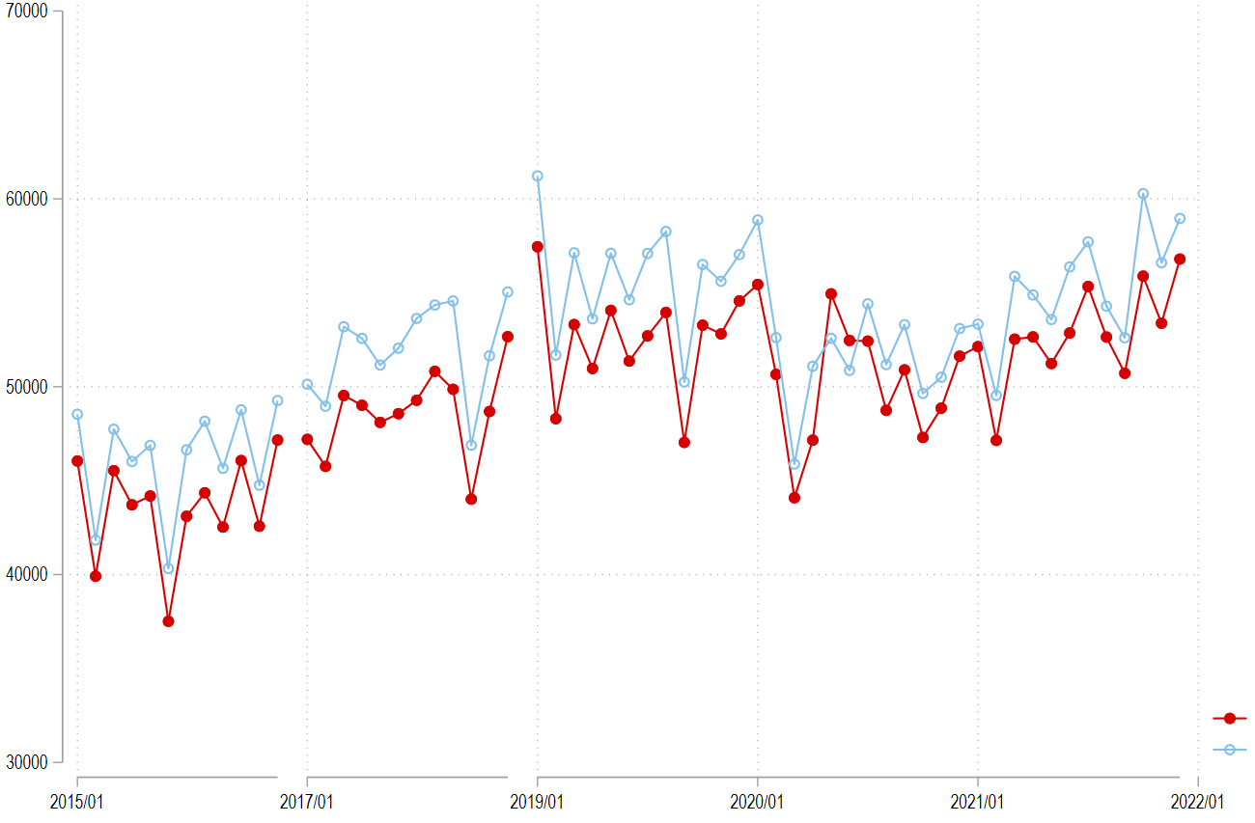
Exploratory Data Analysis
[Shifts by Sex] since the emergence of COVID-19, the gap between male and female health spending has noticeably been alleviated
Monthly
Health
Spending
(KRW)
Male
Female

Slide 13
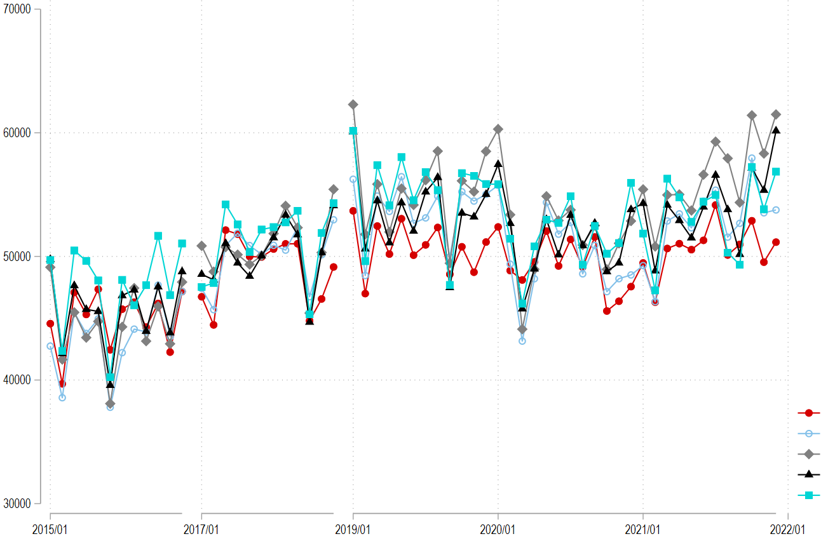
Exploratory Data Analysis
[Shifts by Age] since the second half of 2019, relative to the age group of 60s+,
the age groups of 40s and 50s has significantly increased health spending
Monthly
Health
Spending
(KRW)
20s
30s
40s
50s
60s+

Slide 14
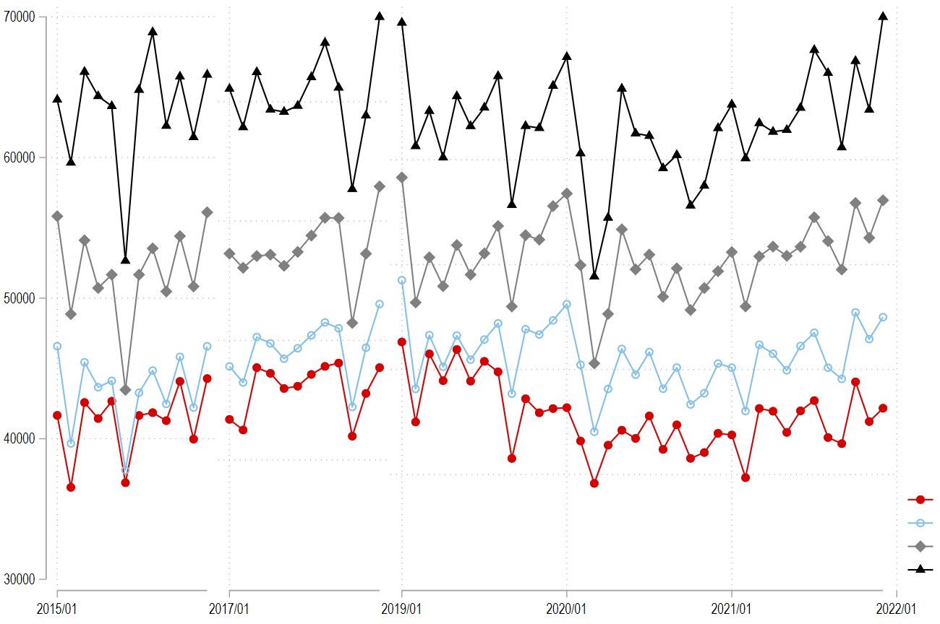
Exploratory Data Analysis
[Shifts by Income] in the pandemic era, there has been an increasing gap between the lowest- and higher-income groups
Monthly
Health
Spending
(KRW)
30M -
30M~50M
50M~70M
70M +

Slide 15
Credit Card Customer Clustering
Customer clustering by utilizing unsupervised machine learning approaches, such as
K-means Clustering based upon pairwise Euclidean distances, and
DBSCAN (Density-based Spatial Clustering of Application with Noise)

Slide 16
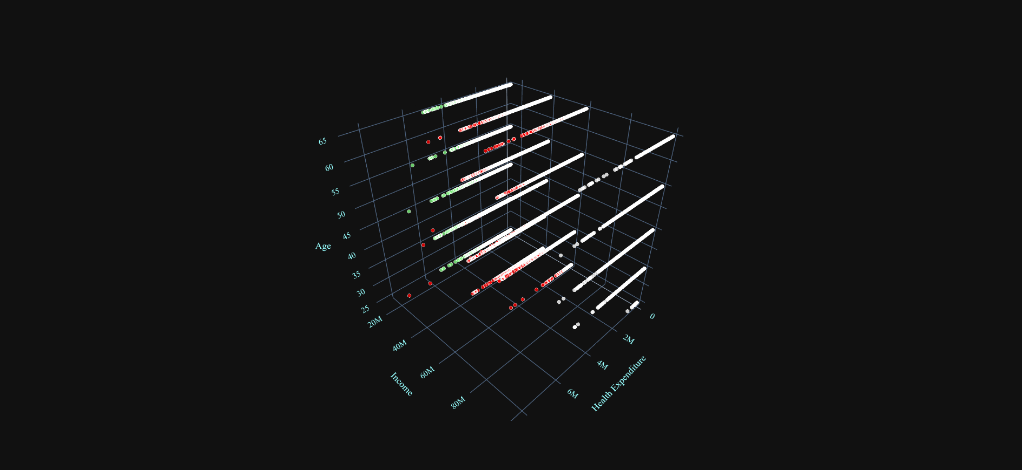
K-Means Clustering

Slide 17
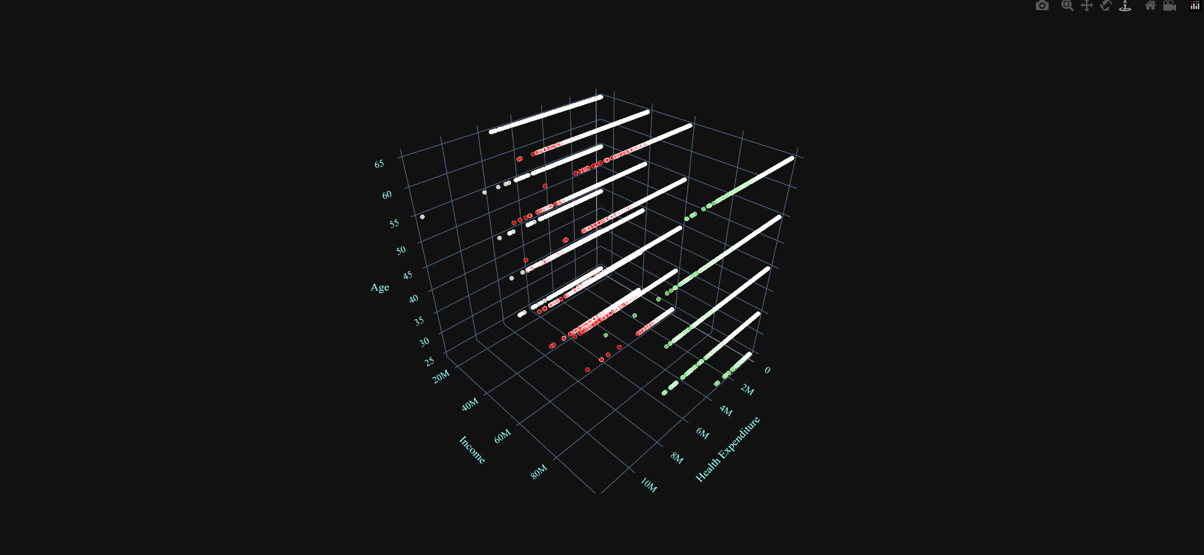
K-Means Clustering

Slide 18
DBSCAN

Slide 19
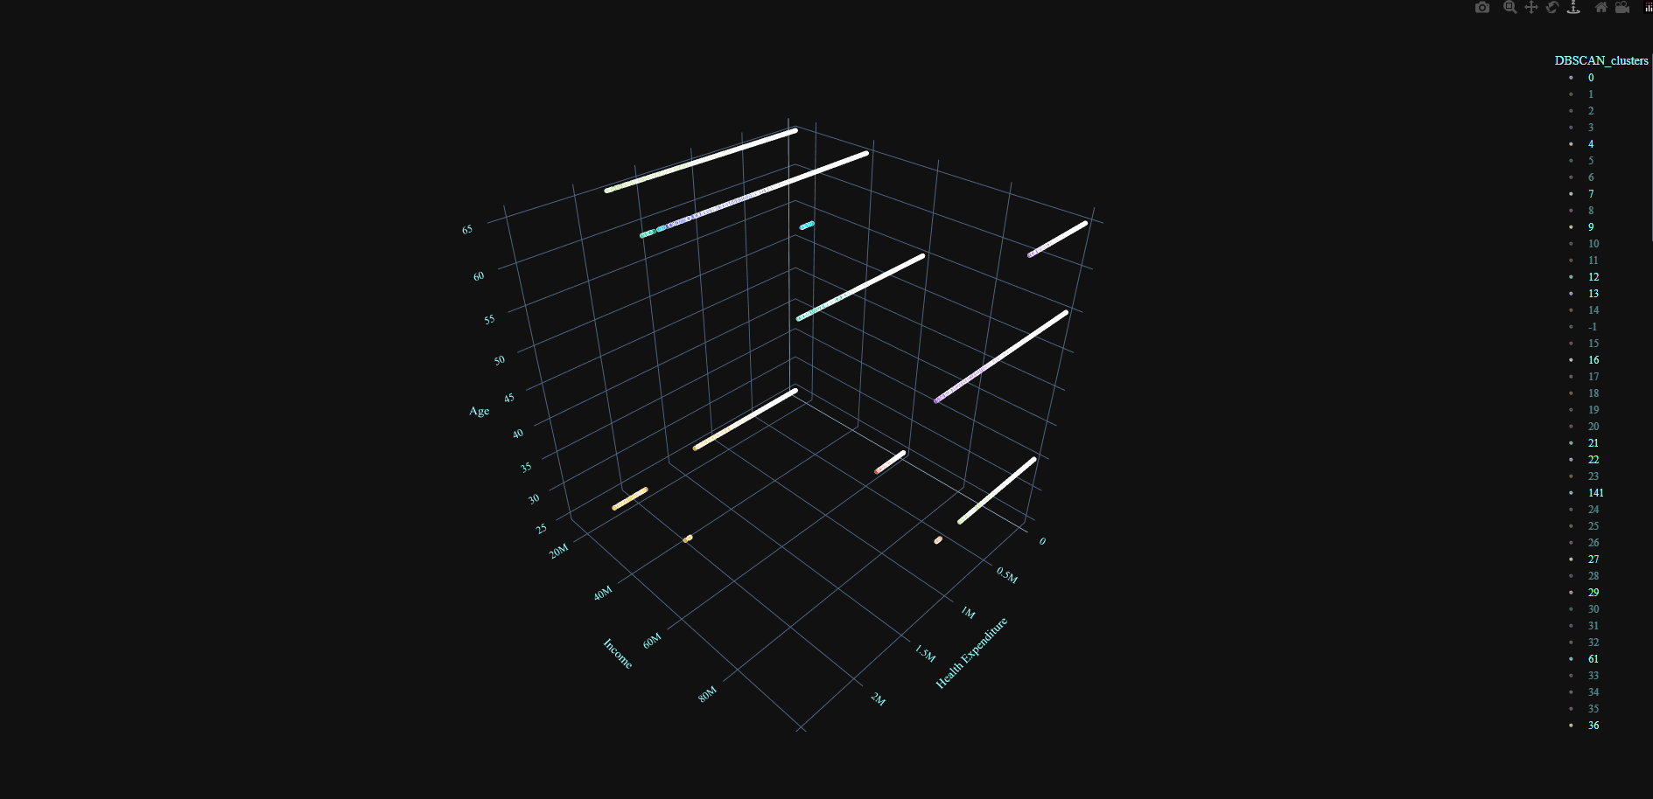
DBSCAN

Slide 20
Related Researches
One of possible channels of such shifts: wealth effects on consumption

Slide 21
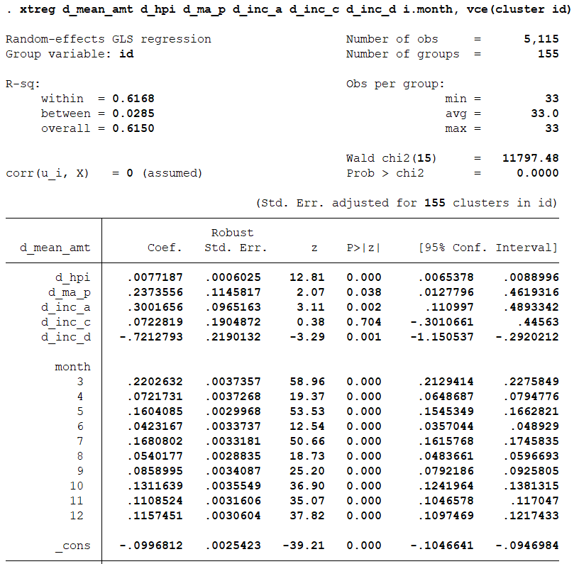
Wealth Effects on Consumption
Pooled OLS estimation (2017, 2019, & 2021)

Slide 22
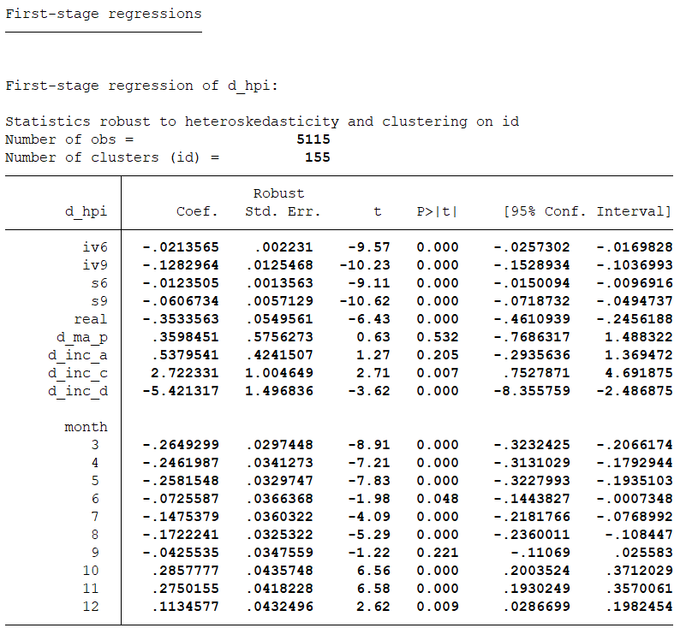
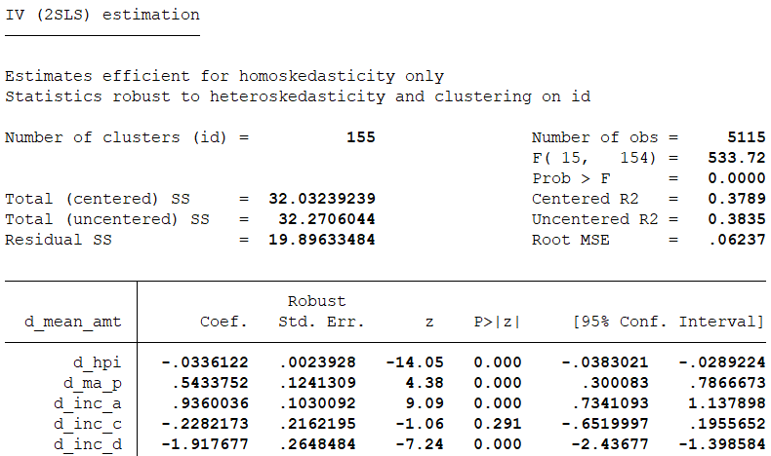
Wealth Effects on Consumption
Pooled IV estimation (2017, 2019, & 2021)

Slide 23
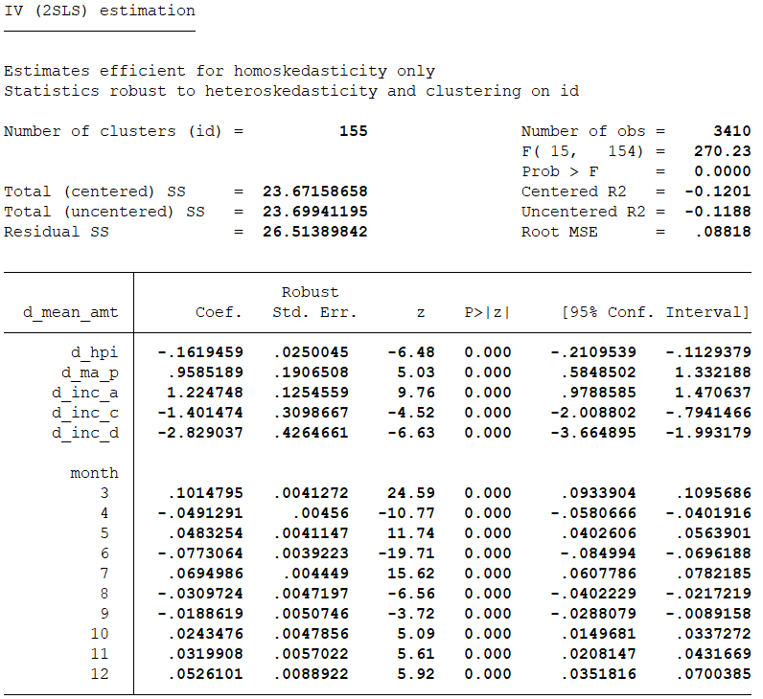
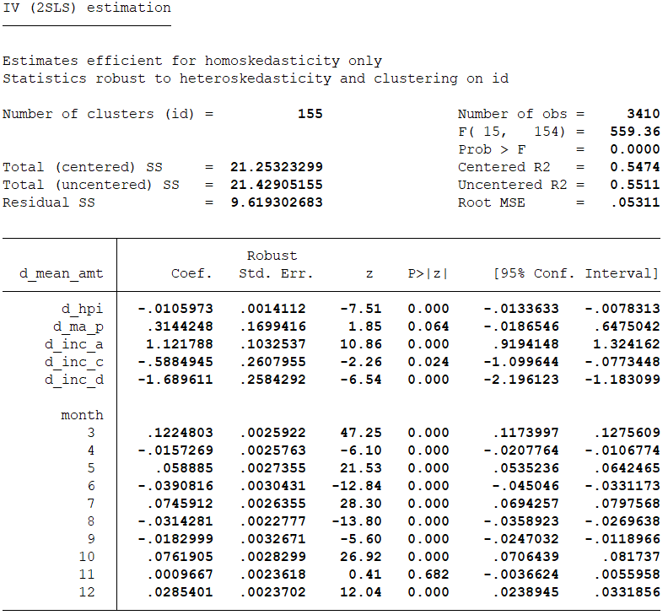
Wealth Effects on Consumption
Pooled IV estimation (2017 & 2019 vs. 2019 & 2021)

